Slide 1
2024 International Conference on Advanced Technologies for Communication (ATC’s 2024)
ATC 2024
2024 International Conference On Advanced Technologies For Communications
17 - 19, October, 2024, Ho Chi Minh City, Vietnam
Enhancing Spectrum Sensing For 5G and LTE With Improved U-Net Architecture
Mr. Duy-Huan Nguyen∗ , Dr. Toan-Van Nguyen†‡, Dr. Thien Huynh-The∗
∗ Department of Computer and Communications Engineering, HCMC University of Technology and Education, Vietnam.
† School of Computer Science and Engineering, International University, Ho Chi Minh City, Vietnam.
‡ Vietnam National University, Ho Chi Minh City, Vietnam.
Email: huan2931@gmail.com, vannguyentoan@gmail.com, thienht@hcmute.edu.vn
Presentation: Mr. Duy-Huan Nguyen
Academic Title: Bachelor of Engineering
Major: Computer Engineering Technology
Institute: Ho Chi Minh City University of Technology and Education Fields of research: Signal processing, Deep learning

Slide 2

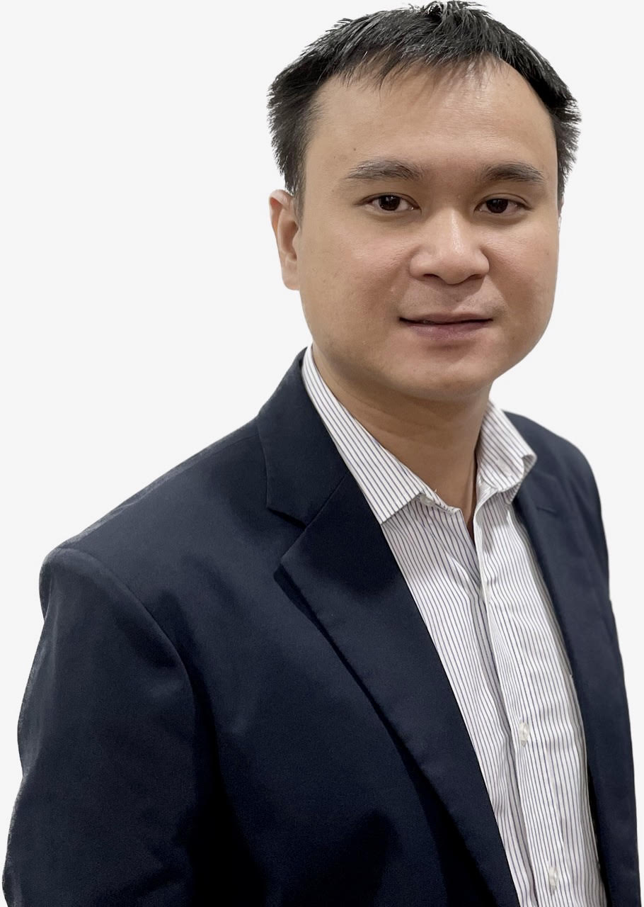

Authors
2024 International Conference on Advanced Technologies for Communication (ATC’s 2024)
Thien Huynh-The (Senior Member, IEEE) received the B.S. degree in Electronics and Telecommunication Engineering and the M.Sc. degree in Electronics Engineering from Ho Chi Minh City University of Technology and Education, Vietnam, in 2011 and 2013, respectively, and the Ph.D. degree in Computer Science and Engineering from Kyung Hee University (KHU), South Korea, in 2018. He was a recipient of the Superior Thesis Prize awarded by KHU. From March 2018 to August 2018, he was a Postdoctoral Researcher with Ubiquitous Computing Laboratory, KHU. From September 2018 to May 2022, he was a Postdoctoral Researcher with the ICT Convergence Research Center, Kumoh National Institute of Technology, South Korea. He is currently an Assistant Professor in Department of Computer and Communication Engineering, Ho Chi Minh City University of Technology and Education (HCMUTE), Vietnam. He was a recipient of Golden Globe Award 2020 for Vietnamese Young Scientist by Central Ho Chi Minh Communist Youth Union associated with Ministry of Science and Technology. His current research interests include digital image processing, radio signal processing, computer vision, wireless communications, IoT applications, machine learning, and deep learning.
Toan-Van Nguyen (Member, IEEE) received the B.S. degree in Electronics and Telecommunications Technology and the M.Eng. degree in Electronic Engineering from HCMC University of Technology and Education, Vietnam, in 2011 and 2014, respectively, and the Ph.D. degree in Electronics and Computer Engineering from Hongik University, South Korea, in 2021. He is currently a Postdoctoral Researcher in the Department of Electrical and Computer Engineering at San Diego State University, CA 92182, USA.
Duy-Huan Nguyen received the B.E. degree in Computer Engineering Technology in Electronics Engineering from Ho Chi Minh City University of Technology and Education, Vietnam, in 2023. He is currently a master student in Electrical & Electronic Technology in Electronics Engineering from Ho Chi Minh City University of Technology and Education, VietNam, in 2023. His current research interests include IC design, radio signal processing and deep learning.

Slide 3
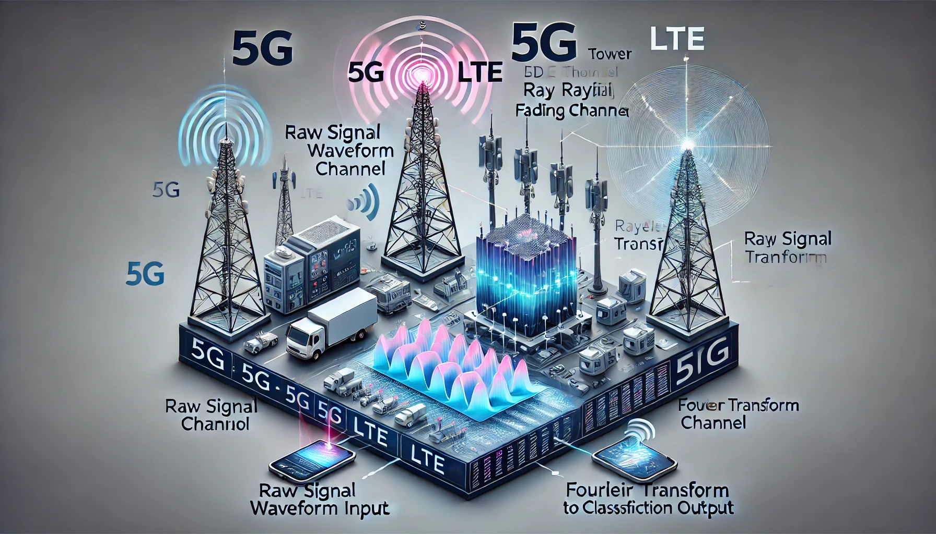
Outline
2024 International Conference on Advanced Technologies for Communication (ATC’s 2024)
Introduction
Contribution
Methology
Proposal model
Evaluation result
Conclusion

Slide 4
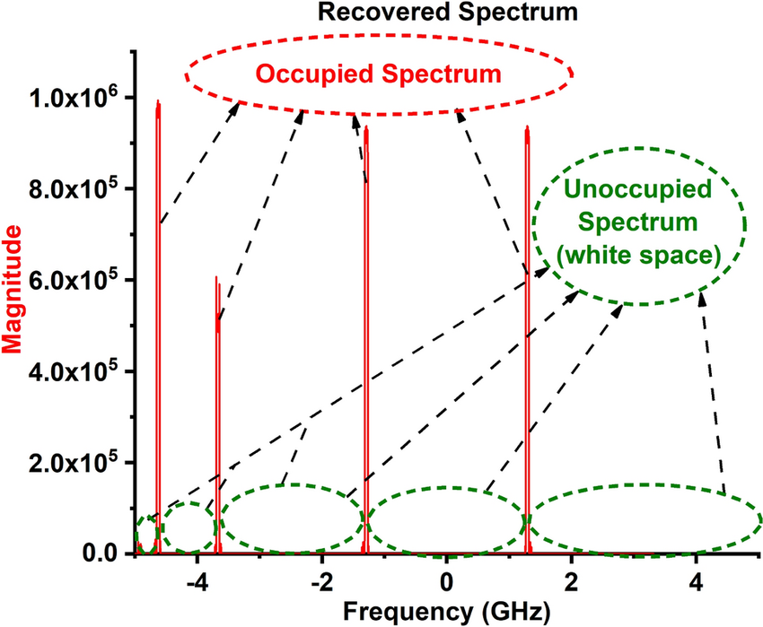
1. Introduction
2024 International Conference on Advanced Technologies for Communication (ATC’s 2024)
Spectrum sensing definition & Challenges
Definition of Spectrum Sensing: Identifying the availability and non availability of wireless or radio communication networks in particular frequency bands.
Problem with Traditional Frequency Allocation: Traditional frequency allocation schemes may fail to meet high data rate demands, leading to inefficient use of spectrum resources.
Spectrum Resource Utilization: Unused spectrum resources can be allocated to other communication systems in need, like 5G NR (New Radio) and LTE (Long-Term Evolution).
Importance for 5G NR and LTE: Spectrum sensing has become a key topic for 5G NR and LTE, with a focus on managing and optimizing the use of limited spectrum resources.
Challenges and Focus Areas: The main challenge is enhancing the performance of monitoring and managing limited spectrum resources more effectively.
[1] T. Huynh-The, Q.-V. Pham, T.-V. Nguyen, T. T. Nguyen, R. Ruby, M. Zeng, and D.-S. Kim, “Automatic modulation classification: A deep architecture survey,” IEEE Access, vol. 9, pp. 142 950–142 971, Oct. 2021.
[3] T. Yucek and H. Arslan, “A survey of spectrum sensing algorithms for cognitive radio applications,” IEEE Communications Surveys & Tutorials, vol. 11, no. 1, pp. 116–130, Mar. 2009.

Slide 5
1. Introduction
2024 International Conference on Advanced Technologies for Communication (ATC’s 2024)
Spectrum sensing based on Deep Learning
Existing Sensing Techniques: Various techniques such as sensing algorithms, multi-dimensional spectrum sensing, channel estimation, and cooperative sensing have been introduced for spectrum sensing.
Hardware Challenges: Spectrum sensing faces significant hardware challenges, requiring high sampling rates, high-resolution analog-to-digital converters (ADCs) with large dynamic ranges, and high-performance processors.
Cognitive Wireless Communication: Cognitive wireless communication systems are categorized based on sensing duration and frequency.
Trade-off Between Performance and Complexity: Spectrum sensing methods involve balancing performance with the complexity of sensing algorithms.
Research Focus: Researchers have been working on improving spectrum sensing to address challenges and develop innovative solutions that enhance accuracy and performance in cognitive wireless networks.
Machine Learning-Based Solutions: Recent research includes the use of machine learning to create intelligent spectrum sensing solutions, which are comprehensively reviewed in several prominent surveys.
[3] T. Yucek and H. Arslan, “A survey of spectrum sensing algorithms for cognitive radio applications,” IEEE Communications Surveys & Tutorials, vol. 11, no. 1, pp. 116–130, Mar. 2009.
[4] A. Kumar, N. Gaur, S. Chakravarty, M. H. Alsharif, P. Uthansakul, and M. Uthansakul, “Analysis of spectrum sensing using deep learning algorithms: CNNs and RNNs,” Ain Shams Engineering Journal, vol. 15, no. 3, p. 102505, Mar. 2024.
[5] A. Ali and W. Hamouda, “Advances on spectrum sensing for cogni_x0002_tive radio networks: Theory and applications,” IEEE Communications Surveys & Tutorials, vol. 19, no. 2, pp. 1277–1304, Jun. 2017.
[6] S. D. Liyanaarachchi, T. Riihonen, C. B. Barneto, and M. Valkama, “Optimized waveforms for 5G–6G communication with sensing: Theory, simulations and experiments,” IEEE Transactions on Wireless Commu_x0002_nications, vol. 20, no. 12, pp. 8301–8315, Dec. 2021.

Slide 6
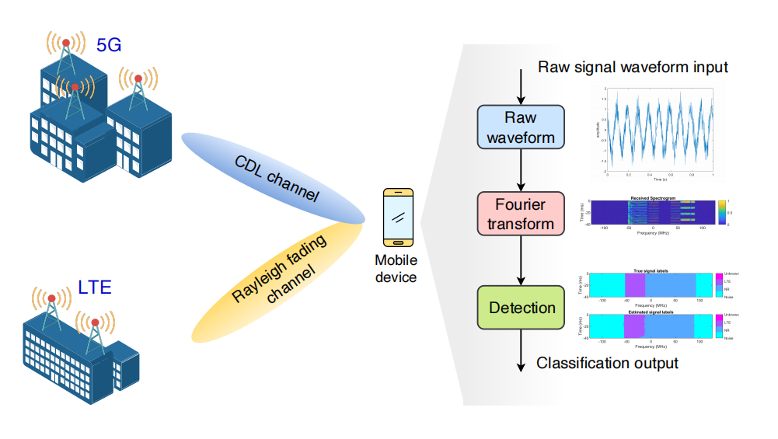
1. Introduction
2024 International Conference on Advanced Technologies for Communication (ATC’s 2024)
Spectrum sensing based on Deep Learning infastructure
Spectrum sensing based on deep learning uses deep learning model to dectect spectrogram and predict signal lables in specific bandwith. Therefore, it provide higher prediction performance than other methods
[6] S. D. Liyanaarachchi, T. Riihonen, C. B. Barneto, and M. Valkama, “Optimized waveforms for 5G–6G communication with sensing: Theory, simulations and experiments,” IEEE Transactions on Wireless Commu_x0002_nications, vol. 20, no. 12, pp. 8301–8315, Dec. 2021.
[7] T. Huynh-The, N. C. Luong, H. Phan, D. B. da Costa, and Q.-V. Pham, “Improved waveform classification for integrated radar-communication 6G systems via convolutional neural networks,” IEEE Transactions on Vehicular Technology, pp. 1–5, Apr. 2024.
[8] T. Huynh-The, Q.-V. Pham, T.-H. Vu, D. B. da Costa, and V.-P. Hoang,“Intelligent spectrum sensing with convnet for 5G and LTE signals identification,” in Proc. IEEE Statistical Signal Processing Workshop (SSP), Hanoi, Vietnam, Jul. 2023, pp. 140–144.
[9] G.-V. Nguyen, C. V. Phan, and T. Huynh-The, “Accurate spectrum sens_x0002_ing with improved DeepLabV3+ for 5G-LTE signals identification,” in Proc. 12th International Symposium on Information and CommunicationTechnology (SOICT), Ho Ch iMinh, Vietnam, Dec. 2023, pp. 221–227.

Slide 7
1. Introduction
2024 International Conference on Advanced Technologies for Communication (ATC’s 2024)
Spectrum sensing based on Deep Learning infastructure
Spectrum sensing based on deep learning uses deep learning model to dectect spectrogram and predict signal lables in specific bandwith. Therefore, it provide higher prediction performance than other methods
Raw communication signals will be transfered to spectrogram (2D) by fast fourier transform
[6] S. D. Liyanaarachchi, T. Riihonen, C. B. Barneto, and M. Valkama, “Optimized waveforms for 5G–6G communication with sensing: Theory, simulations and experiments,” IEEE Transactions on Wireless Commu_x0002_nications, vol. 20, no. 12, pp. 8301–8315, Dec. 2021.
[7] T. Huynh-The, N. C. Luong, H. Phan, D. B. da Costa, and Q.-V. Pham, “Improved waveform classification for integrated radar-communication 6G systems via convolutional neural networks,” IEEE Transactions on Vehicular Technology, pp. 1–5, Apr. 2024.
[8] T. Huynh-The, Q.-V. Pham, T.-H. Vu, D. B. da Costa, and V.-P. Hoang,“Intelligent spectrum sensing with convnet for 5G and LTE signals identification,” in Proc. IEEE Statistical Signal Processing Workshop (SSP), Hanoi, Vietnam, Jul. 2023, pp. 140–144.
[9] G.-V. Nguyen, C. V. Phan, and T. Huynh-The, “Accurate spectrum sens_x0002_ing with improved DeepLabV3+ for 5G-LTE signals identification,” in Proc. 12th International Symposium on Information and CommunicationTechnology (SOICT), Ho Ch iMinh, Vietnam, Dec. 2023, pp. 221–227.

Slide 8
1. Introduction
2024 International Conference on Advanced Technologies for Communication (ATC’s 2024)
Spectrum sensing based on Deep Learning infastructure
Spectrum sensing based on deep learning uses deep learning model to dectect spectrogram and predict signal lables in specific bandwith. Therefore, it provide higher prediction performance than other methods
Applying Deep learning model to predict signal lables in specific bandwith at this process
[6] S. D. Liyanaarachchi, T. Riihonen, C. B. Barneto, and M. Valkama, “Optimized waveforms for 5G–6G communication with sensing: Theory, simulations and experiments,” IEEE Transactions on Wireless Commu_x0002_nications, vol. 20, no. 12, pp. 8301–8315, Dec. 2021.
[7] T. Huynh-The, N. C. Luong, H. Phan, D. B. da Costa, and Q.-V. Pham, “Improved waveform classification for integrated radar-communication 6G systems via convolutional neural networks,” IEEE Transactions on Vehicular Technology, pp. 1–5, Apr. 2024.
[8] T. Huynh-The, Q.-V. Pham, T.-H. Vu, D. B. da Costa, and V.-P. Hoang,“Intelligent spectrum sensing with convnet for 5G and LTE signals identification,” in Proc. IEEE Statistical Signal Processing Workshop (SSP), Hanoi, Vietnam, Jul. 2023, pp. 140–144.
[9] G.-V. Nguyen, C. V. Phan, and T. Huynh-The, “Accurate spectrum sens_x0002_ing with improved DeepLabV3+ for 5G-LTE signals identification,” in Proc. 12th International Symposium on Information and CommunicationTechnology (SOICT), Ho Ch iMinh, Vietnam, Dec. 2023, pp. 221–227.

Slide 9
2. Contribution
2024 International Conference on Advanced Technologies for Communication (ATC’s 2024)
Proposal of SpecSenseNet: A new U-Net-based deep network architecture called Spectrum Sensing Network (SpecSenseNet) is proposed, designed to reduce network size and enhance performance for 5G and LTE signals.
SpecSenseNet Enhancements: SpecSenseNet addresses these limitations by incorporating:
Depth-wise separable convolutions: Reduce computational complexity in both encoder and decoder paths.
Recurrent residual convolutions: Replace standard U-Net blocks to maintain segmentation accuracy.
Atrous Pyramid Spatial Pooling: Injected between the encoder and decoder to enhance feature learning at multiple scales.
Contributions:
Reduction of network’s parameters.
Maintenance of segmentation accuracy.
Inclusion of efficient modules like depth-wise convolutions and Atrous Pyramid Spatial Pooling.
[11] W. Weng and X. Zhu, “INet: Convolutional networks for biomedical image segmentation,” IEEE Access, vol. 9, pp. 16 591–16 603, Jan. 2021.
[12] Z. Zhou, M. M. R. Siddiquee, N. Tajbakhsh, and J. Liang, “Unet++: Redesigning skip connections to exploit multiscale features in image segmentation,” IEEE Transactions on Medical Imaging, vol. 39, no. 6, pp. 1856–1867, Jun. 2019.
[13] F. Chollet, “Xception: Deep learning with depthwise separable convo_x0002_lutions,” in Proc. IEEE Conference on Computer Vision and Pattern Recognition (CVPR), Honolulu, HI, USA, Nov. 2017, pp. 1800–1807.
[14] M. Z. Alom, C. Yakopcic, T. M. Taha, and V. K. Asari, “Nuclei seg_x0002_mentation with recurrent residual convolutional neural networks based U-Net (R2U-Net),” in Proc. IEEE National Aerospace and Electronics Conference, Dayton, OH, USA, Dec. 2018, pp. 228–233.
[16] M. Aghalari, A. Aghagolzadeh, and M. Ezoji, “Brain tumor image segmentation via asymmetric/symmetric unet based on two-pathway_x0002_residual blocks,” Biomedical Signal Processing and Control, vol. 69, p.102841, Aug. 2021.
[17] L.-C. Chen, G. Papandreou, I. Kokkinos, K. Murphy, and A. L. Yuille, “DeepLab: Semantic image segmentation with deep convolutional nets, atrous convolution, and fully connected crfs,” IEEE Transactions on Pattern Analysis and Machine Intelligence, vol. 40, no. 4, pp. 834–848, Apr. 2018.

Slide 10
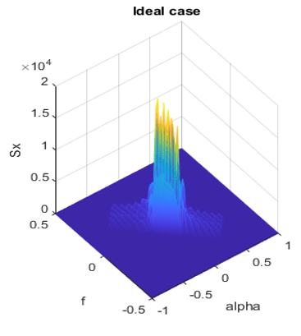
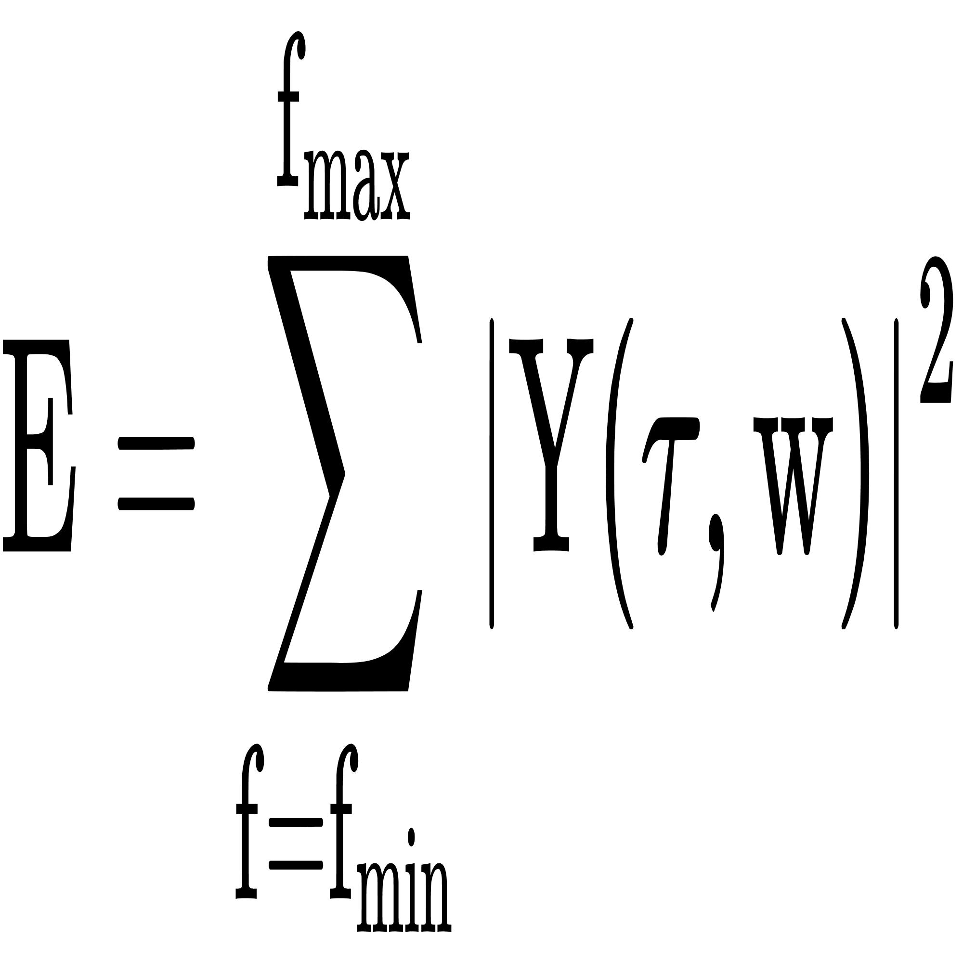
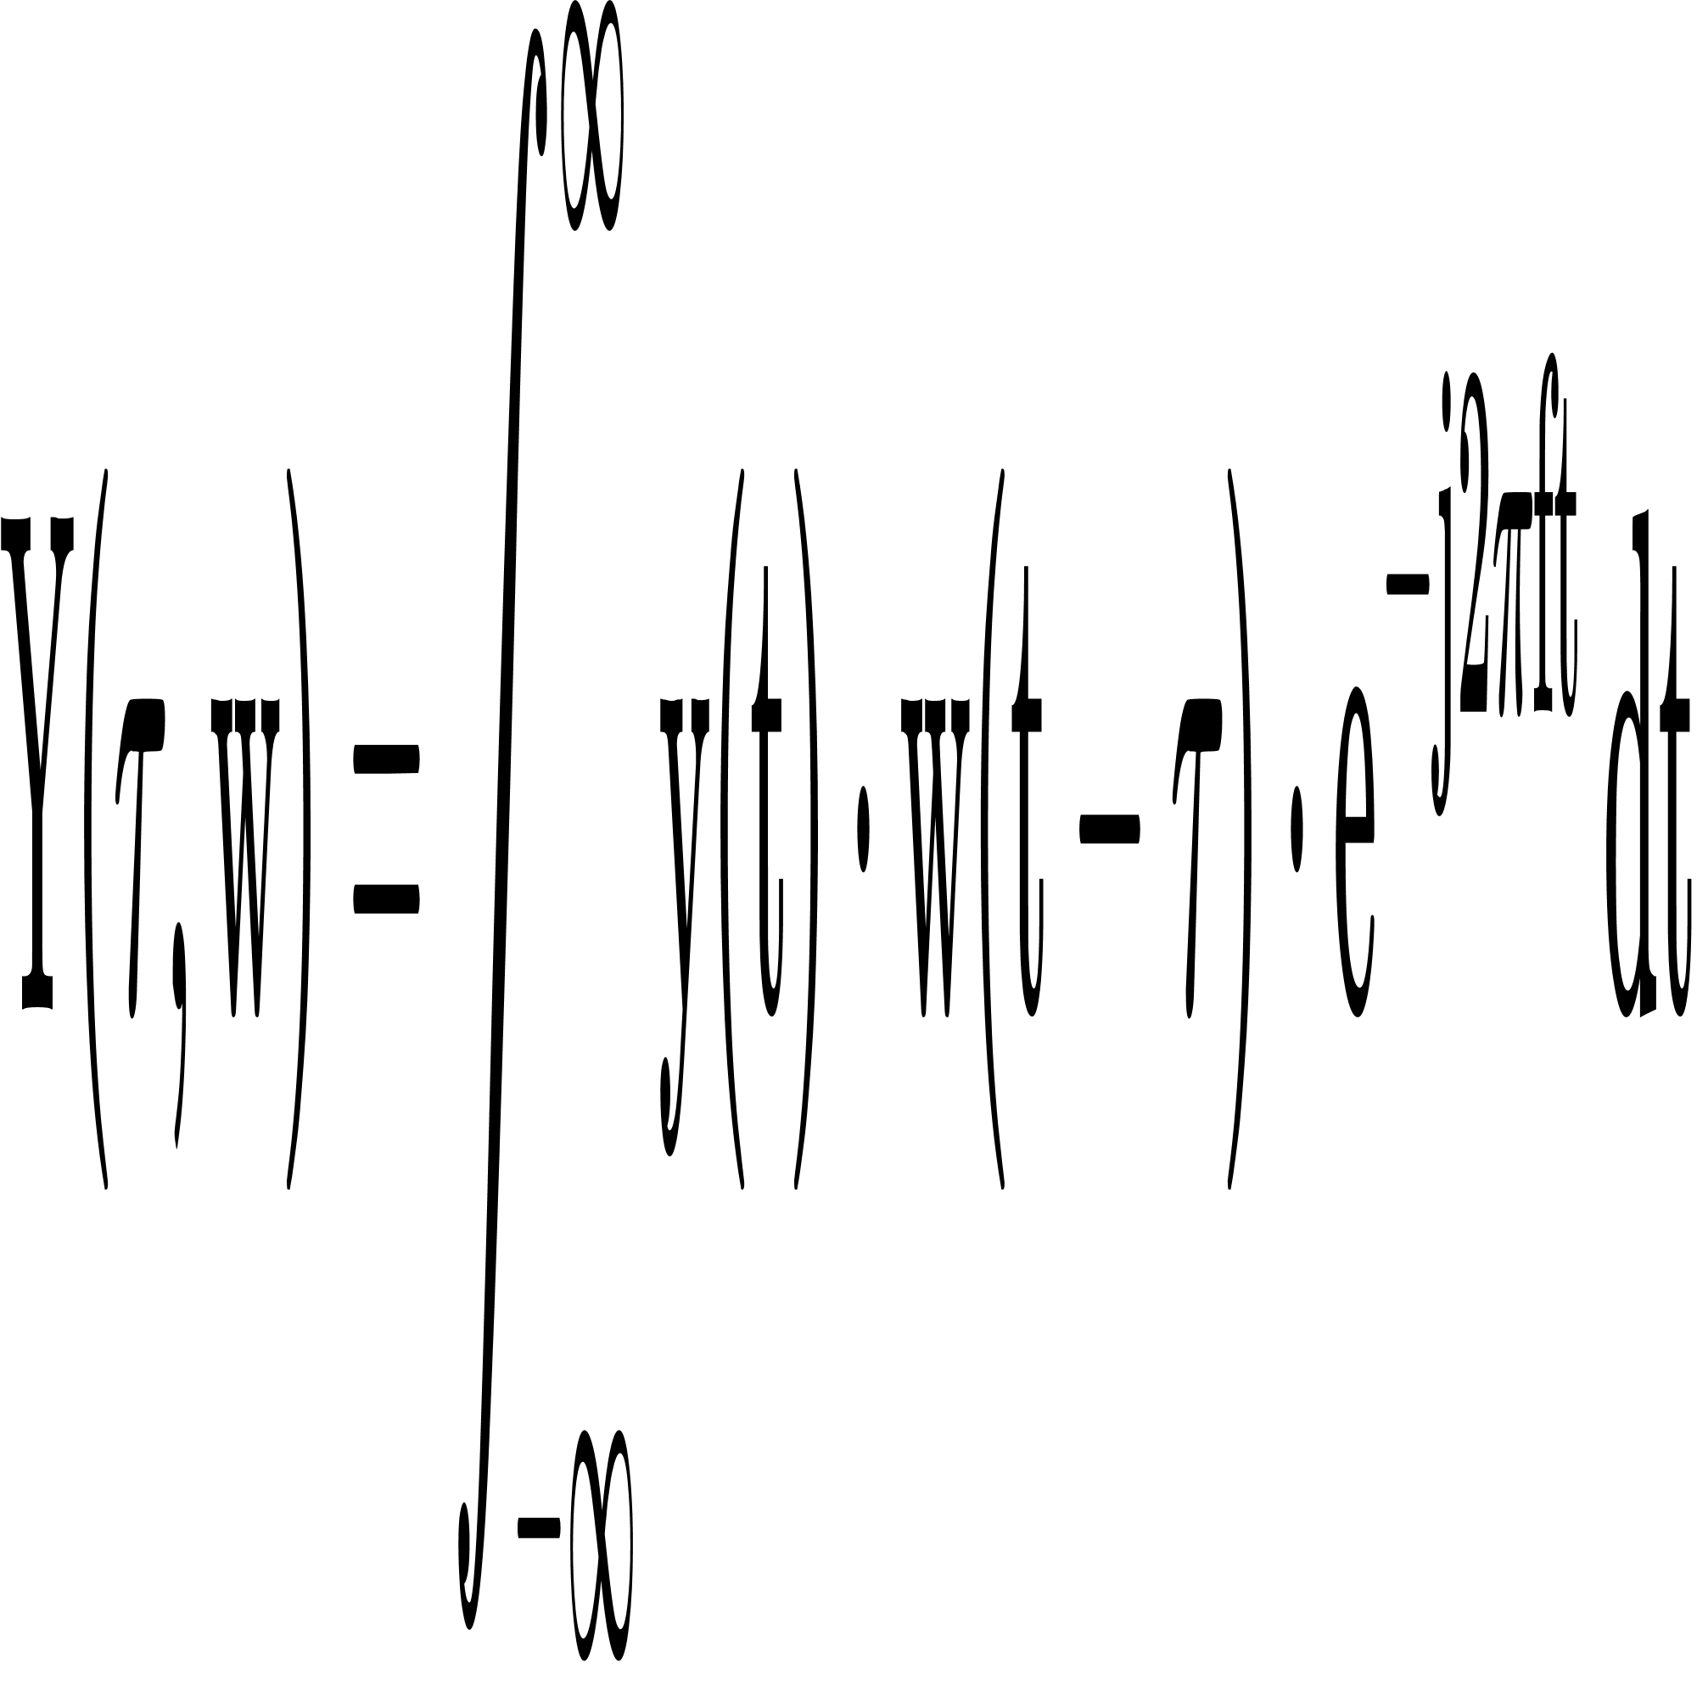
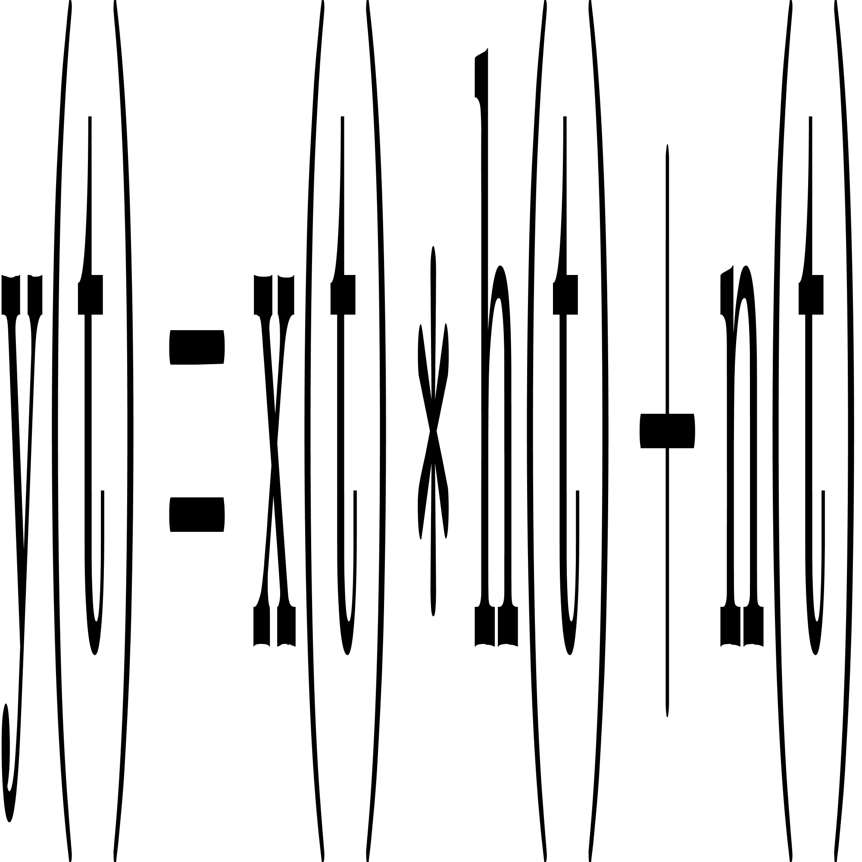
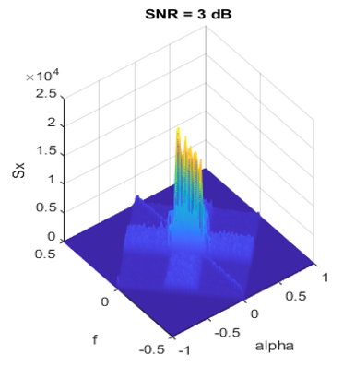
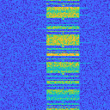

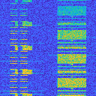
3. Methology
2024 International Conference on Advanced Technologies for Communication (ATC’s 2024)
Signal model
signal transformation in frequency domain using Short-time Fourier transform (STFT)
Energy of signal
RX signal in time domain
y(t): the RX signal
x(t): the transmitted signal (TX signal)
h(t): the channel response
n(t): additive white Gaussian noise (AWGN)
Y (τ, w): the spectrogram of the RX signal
y(t): the input RX signal
w(t − τ ): window function
E: the energy density in the range of frequency
Y (τ, w): the spectrogram of the RX signal
Spectrogram sample
LTE
5G NR
LTE & 5G
[6] S. D. Liyanaarachchi, T. Riihonen, C. B. Barneto, and M. Valkama, “Optimized waveforms for 5G–6G communication with sensing: Theory, simulations and experiments,” IEEE Transactions on Wireless Commu_x0002_nications, vol. 20, no. 12, pp. 8301–8315, Dec. 2021.

Slide 11
3. Methology
2024 International Conference on Advanced Technologies for Communication (ATC’s 2024)
Signal model
signal transformation in frequency domain using Short-time Fourier transform (STFT)
Energy of signal
RX signal in time domain
good
y(t): the RX signal
x(t): the transmitted signal (TX signal)
h(t): the channel response
n(t): additive white Gaussian noise (AWGN)
Y (τ, w): the spectrogram of the RX signal
y(t): the input RX signal
w(t − τ ): window function
E: the energy density in the range of frequency
Y (τ, w): the spectrogram of the RX signal
Spectrogram sample
The gap energy between real signal and noise called SNR (dB)
bad
LTE
5G NR
LTE & 5G
[6] S. D. Liyanaarachchi, T. Riihonen, C. B. Barneto, and M. Valkama, “Optimized waveforms for 5G–6G communication with sensing: Theory, simulations and experiments,” IEEE Transactions on Wireless Commu_x0002_nications, vol. 20, no. 12, pp. 8301–8315, Dec. 2021.

Slide 12
3. Methology
2024 International Conference on Advanced Technologies for Communication (ATC’s 2024)
Signal model
signal transformation in frequency domain using Short-time Fourier transform (STFT)
Energy of signal
RX signal in time domain
y(t): the RX signal
x(t): the transmitted signal (TX signal)
h(t): the channel response
n(t): additive white Gaussian noise (AWGN)
Y (τ, w): the spectrogram of the RX signal
y(t): the input RX signal
w(t − τ ): window function
E: the energy density in the range of frequency
Y (τ, w): the spectrogram of the RX signal
Spectrogram sample
LTE
5G NR
LTE & 5G
[6] S. D. Liyanaarachchi, T. Riihonen, C. B. Barneto, and M. Valkama, “Optimized waveforms for 5G–6G communication with sensing: Theory, simulations and experiments,” IEEE Transactions on Wireless Commu_x0002_nications, vol. 20, no. 12, pp. 8301–8315, Dec. 2021.

Slide 13
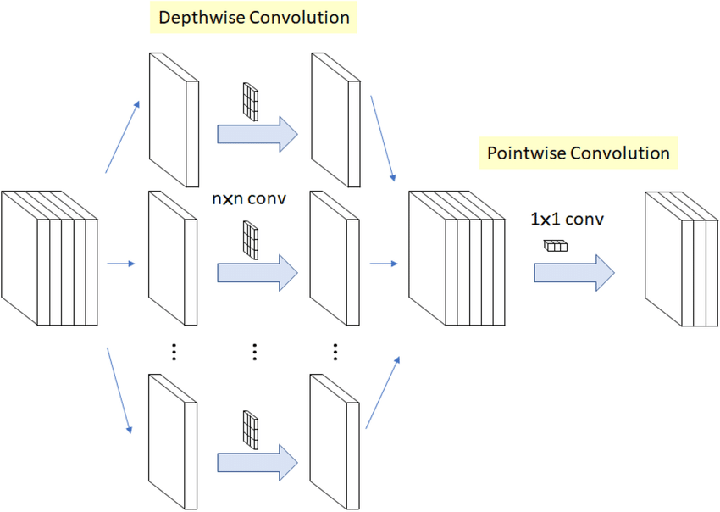
4. Proposal model
2024 International Conference on Advanced Technologies for Communication (ATC’s 2024)
Depth-wise separable convolution
depthwise separable convolutions divide to 2 step with depthwise convolution and pointwise convolution. It contributes to reduce significantly the number of parameter but still remain effectively accuracy.
[13] F. Chollet, “Xception: Deep learning with depthwise separable convo_x0002_lutions,” in Proc. IEEE Conference on Computer Vision and Pattern Recognition (CVPR), Honolulu, HI, USA, Nov. 2017, pp. 1800–1807.

Slide 14
4. Proposal model
2024 International Conference on Advanced Technologies for Communication (ATC’s 2024)
Depth-wise separable convolution
depthwise separable convolutions divide to 2 step with depthwise convolution and pointwise convolution. It contributes to reduce significantly the number of parameter but still remain effectively accuracy.
In the former step, depthwise separable convolution uses multiple kernels (n x n x 1) corresponding with the number channels of input image
k channels
With k channels input, using k (n x n) convolution
[13] F. Chollet, “Xception: Deep learning with depthwise separable convo_x0002_lutions,” in Proc. IEEE Conference on Computer Vision and Pattern Recognition (CVPR), Honolulu, HI, USA, Nov. 2017, pp. 1800–1807.

Slide 15
4. Proposal model
2024 International Conference on Advanced Technologies for Communication (ATC’s 2024)
Depth-wise separable convolution
depthwise separable convolutions divide to 2 step with depthwise convolution and pointwise convolution. It contributes to reduce significantly the number of parameter but still remain effectively accuracy.
In the former step, depthwise separable convolution uses multiple kernels (n x n x 1) corresponding with the number channels of input image
Handling convolution with 2 dimension reduces drammatically the trainable parameters
k channels
[13] F. Chollet, “Xception: Deep learning with depthwise separable convo_x0002_lutions,” in Proc. IEEE Conference on Computer Vision and Pattern Recognition (CVPR), Honolulu, HI, USA, Nov. 2017, pp. 1800–1807.

Slide 16
4. Proposal model
2024 International Conference on Advanced Technologies for Communication (ATC’s 2024)
Depth-wise separable convolution
depthwise separable convolutions divide to 2 step with depthwise convolution and pointwise convolution. It contributes to reduce significantly the number of parameter but still remain effectively accuracy.
In the latter step, the pointwise convolution (1x1 conv) is applied to concat all feature maps from all channels
Using 1 x 1 x k convolution reduce network’s parameters effectively in the latter step.
k channels
1 x 1 x k conv
[13] F. Chollet, “Xception: Deep learning with depthwise separable convo_x0002_lutions,” in Proc. IEEE Conference on Computer Vision and Pattern Recognition (CVPR), Honolulu, HI, USA, Nov. 2017, pp. 1800–1807.

Slide 17
4. Proposal model
2024 International Conference on Advanced Technologies for Communication (ATC’s 2024)
Depth-wise separable convolution
depthwise separable convolutions divide to 2 step with depthwise convolution and pointwise convolution. It contributes to reduce significantly the number of parameter but still remain effectively accuracy.
In the latter step, the pointwise convolution (1x1 conv) is applied to concat all feature maps from all channels
Output feature map
k channels
The output of depthwise separable convolution is similar as the output of normal convolution (n x n x k)
1 x 1 x k conv
[13] F. Chollet, “Xception: Deep learning with depthwise separable convo_x0002_lutions,” in Proc. IEEE Conference on Computer Vision and Pattern Recognition (CVPR), Honolulu, HI, USA, Nov. 2017, pp. 1800–1807.

Slide 18
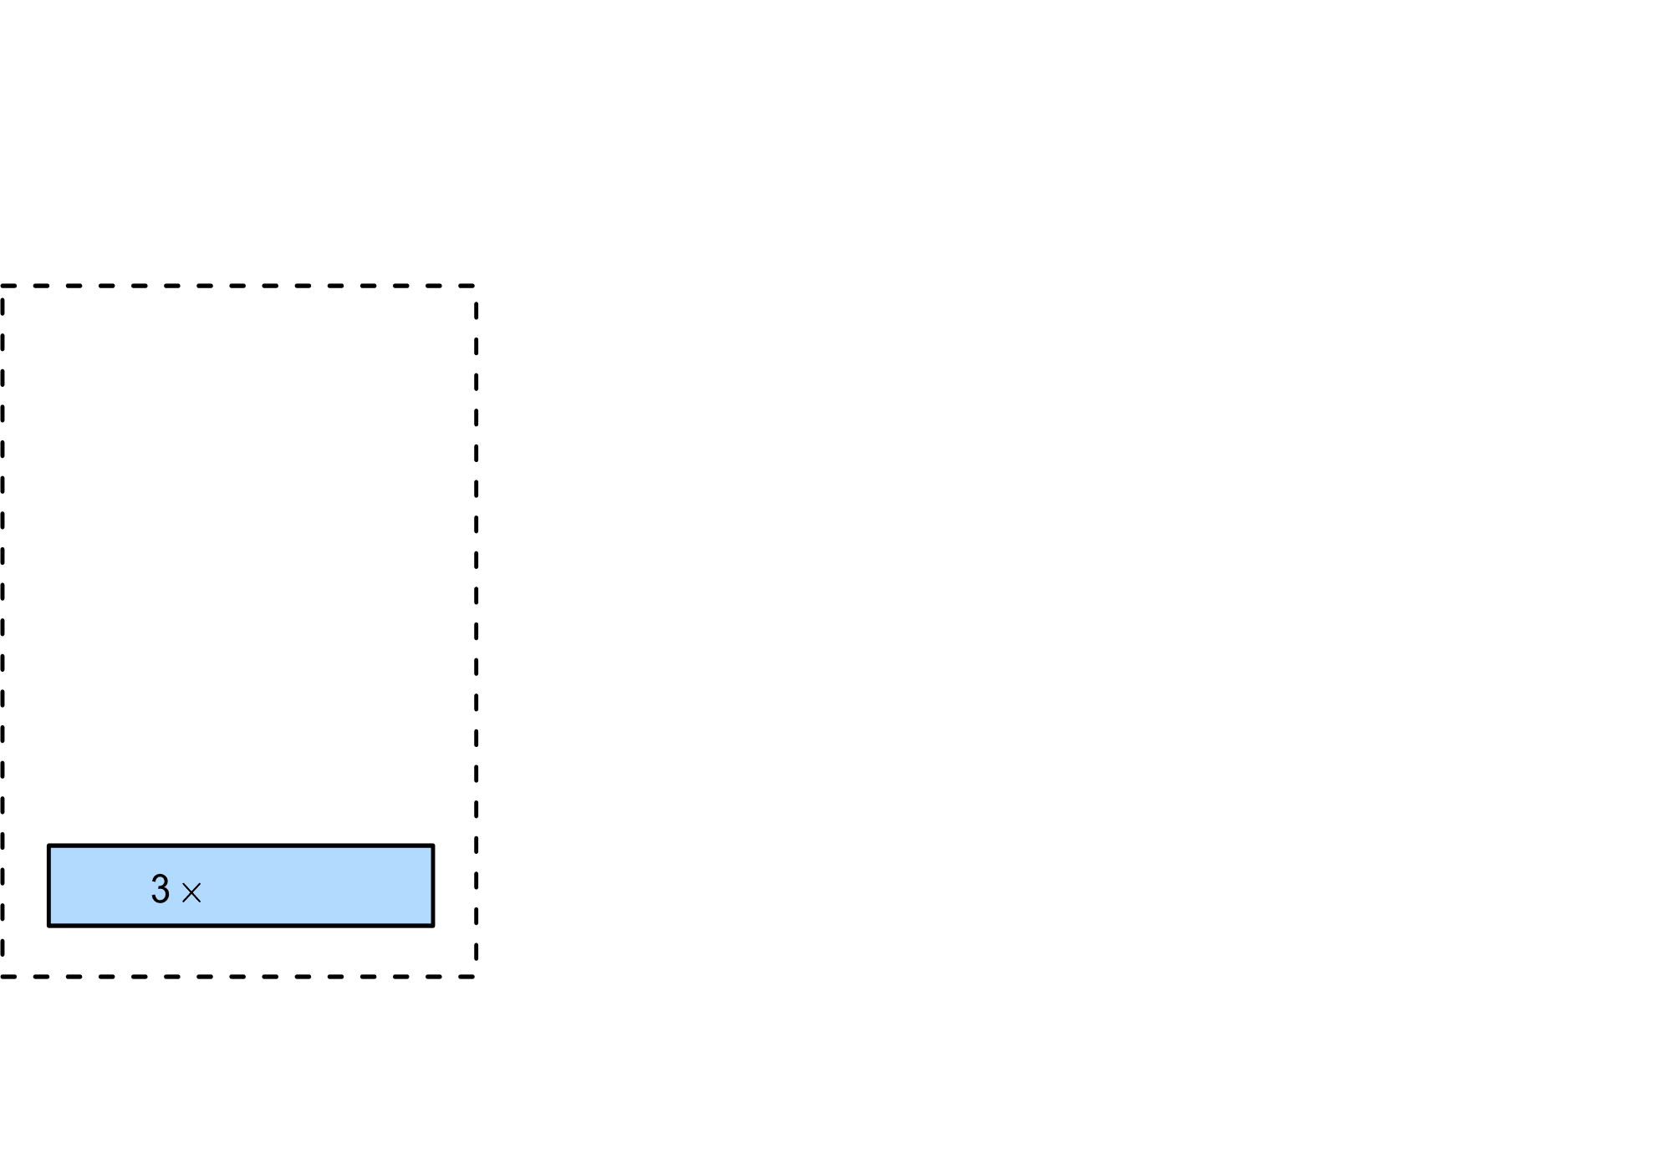
4. Proposal model
2024 International Conference on Advanced Technologies for Communication (ATC’s 2024)
Recurrent residual convolution
Recurrent residual convolution contains residual connection helping the network skip unessential convolution block, which is determined by input data.
[14] M. Z. Alom, C. Yakopcic, T. M. Taha, and V. K. Asari, “Nuclei seg_x0002_mentation with recurrent residual convolutional neural networks based U-Net (R2U-Net),” in Proc. IEEE National Aerospace and Electronics Conference, Dayton, OH, USA, Dec. 2018, pp. 228–233.
[15] K. He, X. Zhang, S. Ren, and J. Sun, “Deep residual learning for image recognition,” in Proc. IEEE Conference on Computer Vision and Pattern Recognition (CVPR), Las Vegas, NV, USA, Dec. 2016, pp. 770–778.
[16] M. Aghalari, A. Aghagolzadeh, and M. Ezoji, “Brain tumor image segmentation via asymmetric/symmetric unet based on two-pathway_x0002_residual blocks,” Biomedical Signal Processing and Control, vol. 69, p.102841, Aug. 2021.

Slide 19
4. Proposal model
2024 International Conference on Advanced Technologies for Communication (ATC’s 2024)
Recurrent residual convolution
Recurrent residual convolution contains residual connection helping the network skip unessential convolution block, which is determined by input data.
Residual connection
Using 1 x 1 x k conv to synchronize the number of channels at the output
[14] M. Z. Alom, C. Yakopcic, T. M. Taha, and V. K. Asari, “Nuclei seg_x0002_mentation with recurrent residual convolutional neural networks based U-Net (R2U-Net),” in Proc. IEEE National Aerospace and Electronics Conference, Dayton, OH, USA, Dec. 2018, pp. 228–233.
[15] K. He, X. Zhang, S. Ren, and J. Sun, “Deep residual learning for image recognition,” in Proc. IEEE Conference on Computer Vision and Pattern Recognition (CVPR), Las Vegas, NV, USA, Dec. 2016, pp. 770–778.
[16] M. Aghalari, A. Aghagolzadeh, and M. Ezoji, “Brain tumor image segmentation via asymmetric/symmetric unet based on two-pathway_x0002_residual blocks,” Biomedical Signal Processing and Control, vol. 69, p.102841, Aug. 2021.

Slide 20
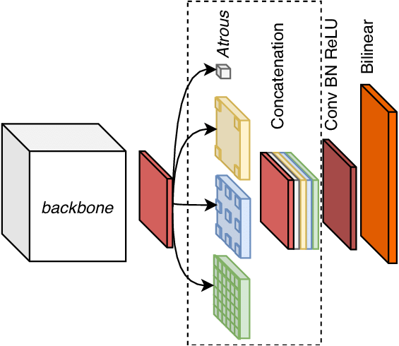
4. Proposal model
2024 International Conference on Advanced Technologies for Communication (ATC’s 2024)
Atrous Pyramid Spatial Pooling
Atrous pyramid spatial pooling implements paralell convolution with different multiple sampling rates. It help network retain many general feature maps of the output
[17] L.-C. Chen, G. Papandreou, I. Kokkinos, K. Murphy, and A. L. Yuille, “DeepLab: Semantic image segmentation with deep convolutional nets, atrous convolution, and fully connected crfs,” IEEE Transactions on Pattern Analysis and Machine Intelligence, vol. 40, no. 4, pp. 834–848, Apr. 2018.

Slide 21
4. Proposal model
2024 International Conference on Advanced Technologies for Communication (ATC’s 2024)
Atrous Pyramid Spatial Pooling
Atrous pyramid spatial pooling implements paralell convolution with different multiple sampling rates. It help network retain many general feature maps of the output
Dilate convolution with different rates, it extracts feature maps with many parallel dilation convolution
[17] L.-C. Chen, G. Papandreou, I. Kokkinos, K. Murphy, and A. L. Yuille, “DeepLab: Semantic image segmentation with deep convolutional nets, atrous convolution, and fully connected crfs,” IEEE Transactions on Pattern Analysis and Machine Intelligence, vol. 40, no. 4, pp. 834–848, Apr. 2018.

Slide 22
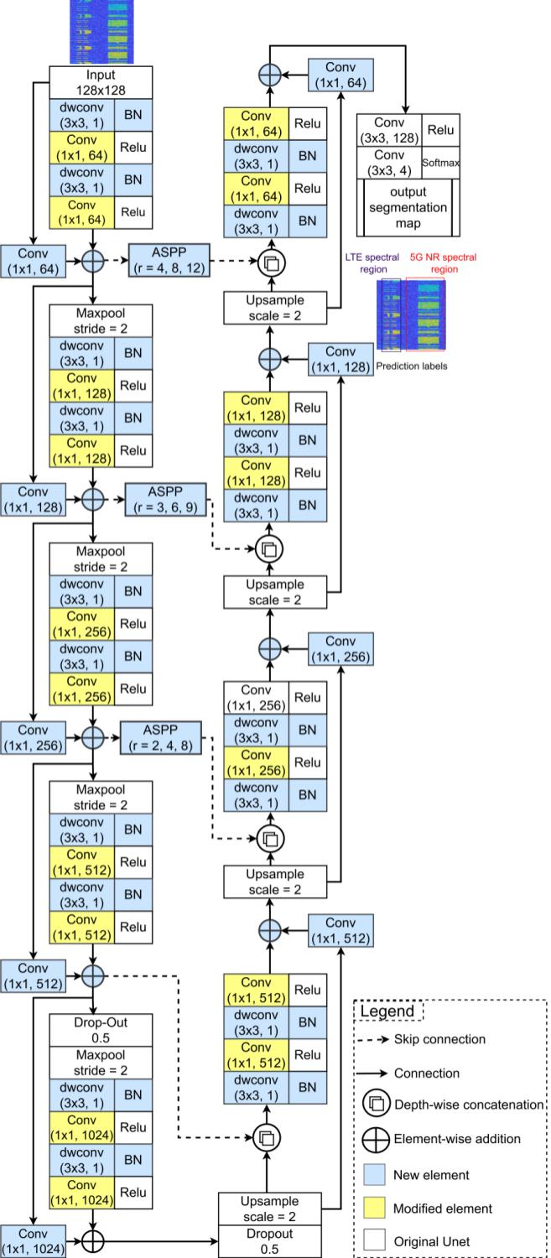
4. Proposal model
2024 International Conference on Advanced Technologies for Communication (ATC’s 2024)
We apply above deep learning techniques to improve Unet architecture
U-Net architecture
SpecSenseNet architecture
Improvement
No.Layers: 59 No.params: 31.3M
No.Layers: 125 No.params: 7.8M

Slide 23
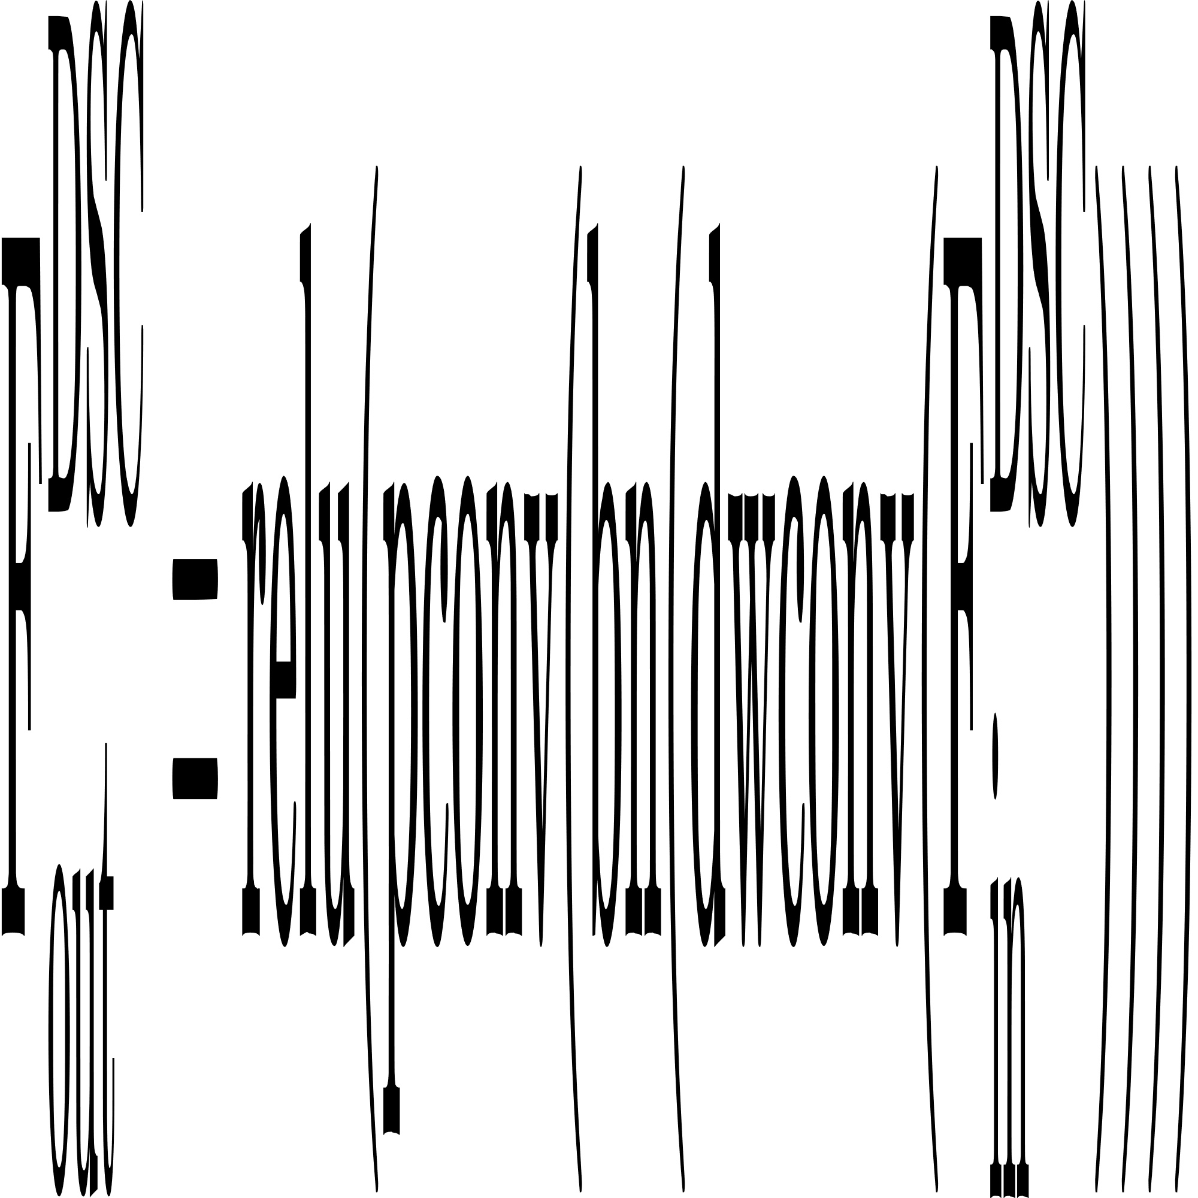
4. Proposal model
2024 International Conference on Advanced Technologies for Communication (ATC’s 2024)
We apply above deep learning techniques to improve Unet architecture
U-Net architecture
SpecSenseNet architecture
All convolutions are replace by depth-wise sparable convolution. It contributes to reudce drammatically the number of paramers in our network
Improvement
No.Layers: 59 No.params: 31.3M
No.Layers: 125 No.params: 7.8M

Slide 24
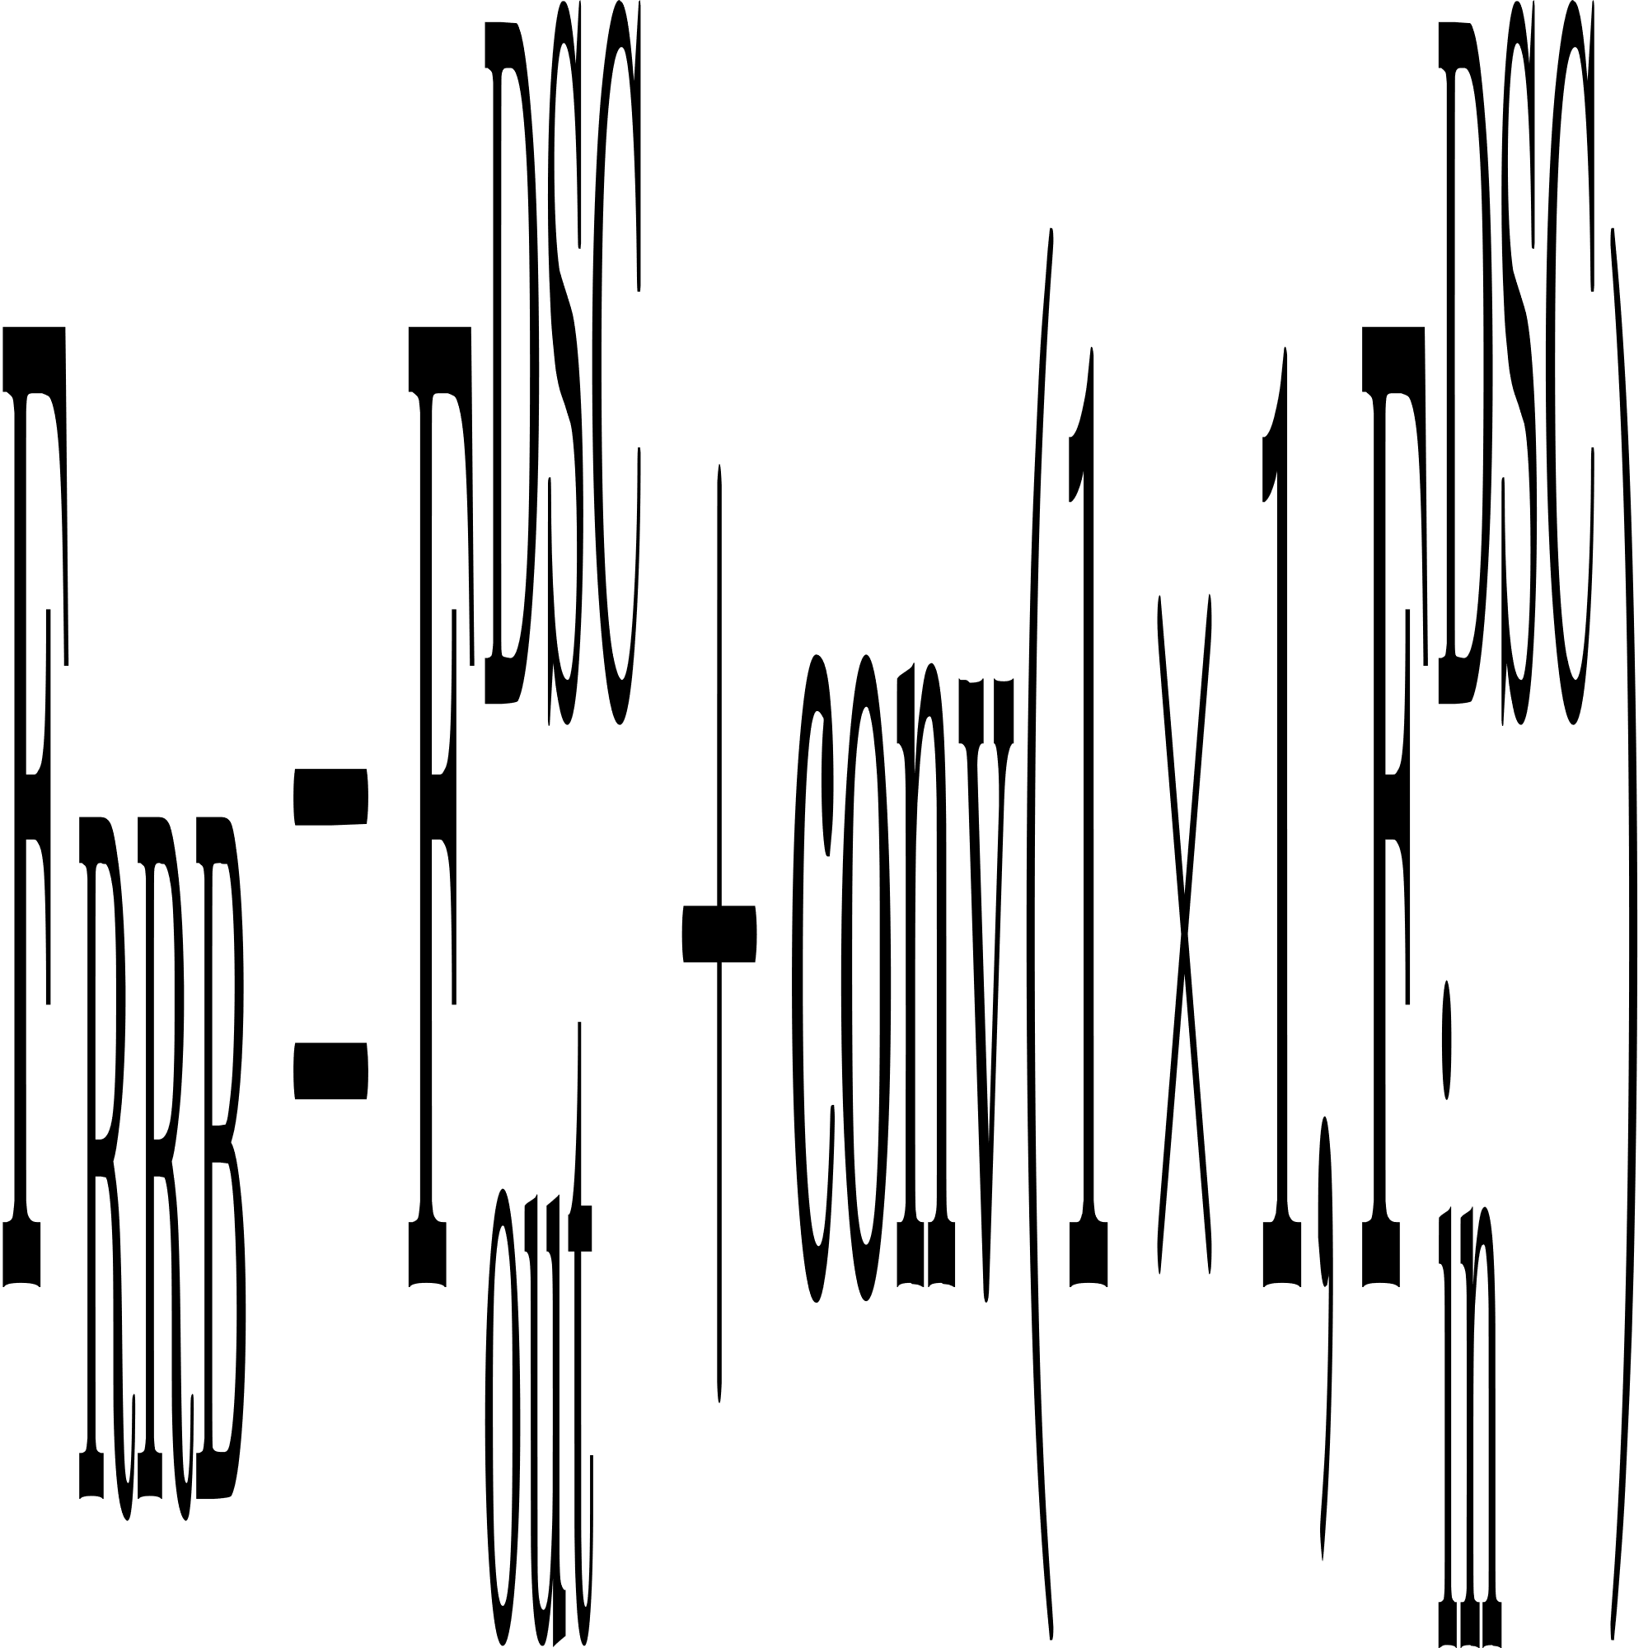
4. Proposal model
2024 International Conference on Advanced Technologies for Communication (ATC’s 2024)
We apply above deep learning techniques to improve Unet architecture
U-Net architecture
SpecSenseNet architecture
Recurrent residual convolution are used for pruning our network that determinate by dataset. It contribute to ignore unimportant features
Improvement
No.Layers: 59 No.params: 31.3M
No.Layers: 125 No.params: 7.8M

Slide 25
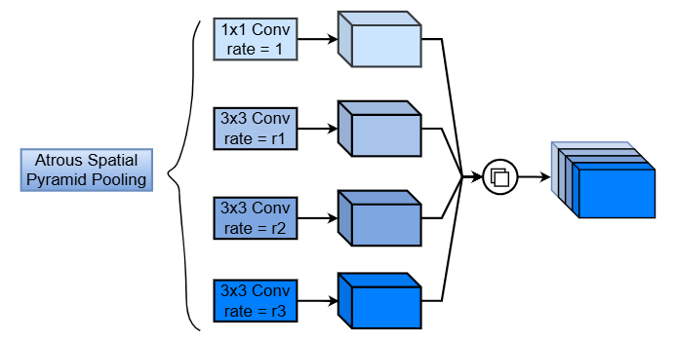
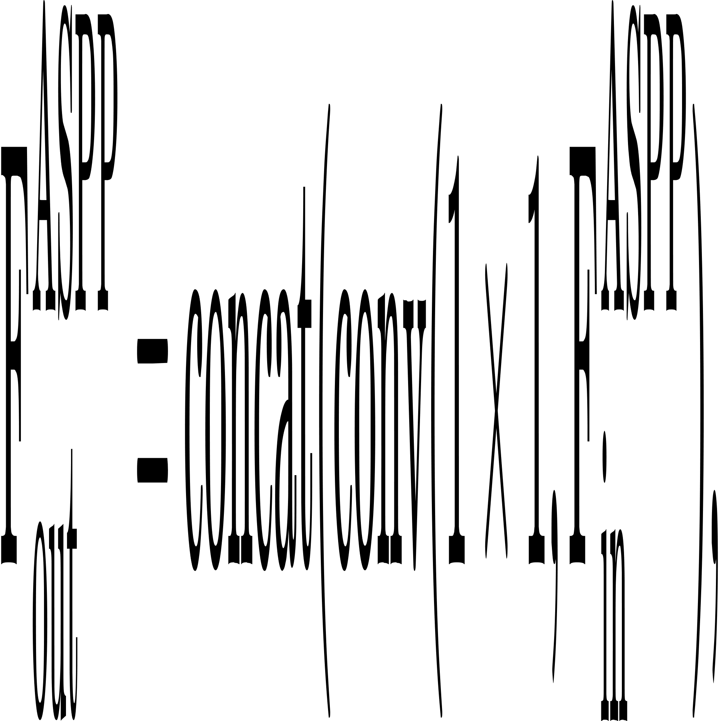
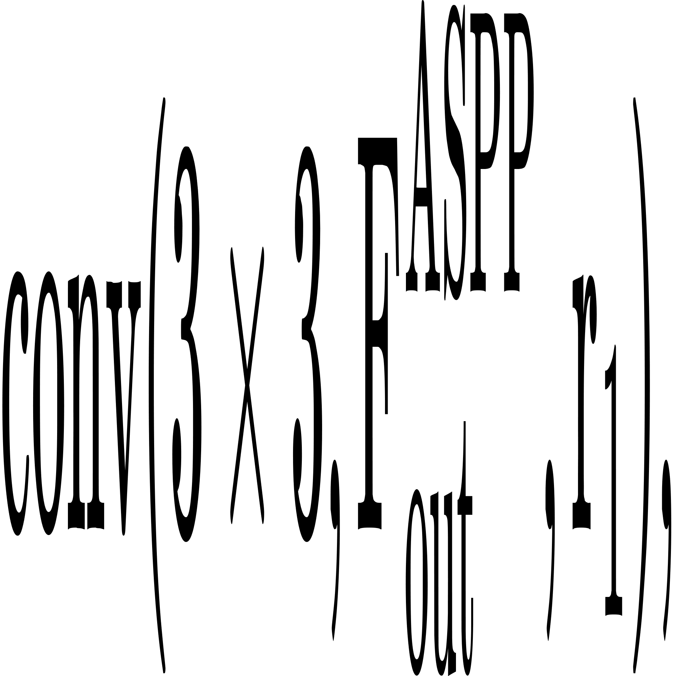
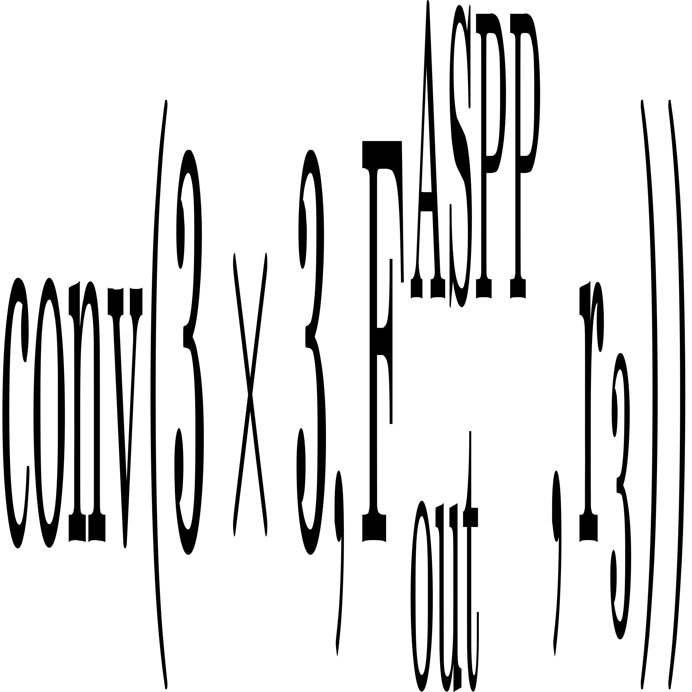
4. Proposal model
2024 International Conference on Advanced Technologies for Communication (ATC’s 2024)
We apply above deep learning techniques to improve Unet architecture
U-Net architecture
SpecSenseNet architecture
Atrous pyramid spatial pooling modules are injected into skip connection wires to feature in multiple receptive feild sizes. It help our network retain general information of input image during encoder process and pass it to decoder process directly. As a result, the general importance information is remained correctly
Improvement
No.Layers: 59 No.params: 31.3M
No.Layers: 125 No.params: 7.8M

Slide 26
4. Proposal model
2024 International Conference on Advanced Technologies for Communication (ATC’s 2024)
We apply above deep learning techniques to improve Unet architecture
U-Net architecture
SpecSenseNet architecture
After improvement, we successfully reduce the number of parameter for SpecSenseNet. the model's efficiency, generalizability, and ease of deployment are enhanced, leveraging state-of-the-art approaches
Improvement
Reducing by 23.5M
No.Layers: 125 No.params: 7.8M
No.Layers: 59 No.params: 31.3M

Slide 27


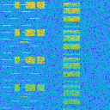
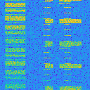
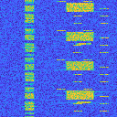
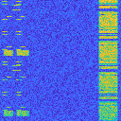
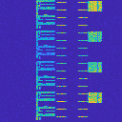
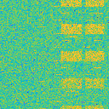
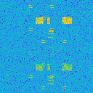
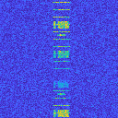
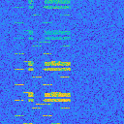
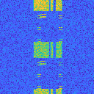
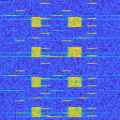
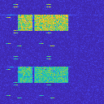
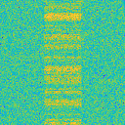
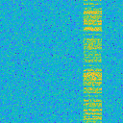

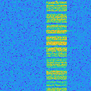
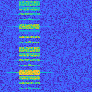

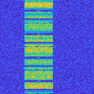
5. Evaluation result
2024 International Conference on Advanced Technologies for Communication (ATC’s 2024)
Dataset Information
Overlapping 5G & LTE spectrogram datasets
5G spectrogram datasets
LTE spectrogram datasets
0 dB
5 dB
10 dB
15 dB
20 dB
25 dB
30 dB
Dataset information
Catelogy | No.Samples | Image size | SNR (dB)
LTE | 5,000 | 128x128 | [0 30]
5G | 5,000 | 128x128 | [0 30]
5G & LTE | 5,000 | 128x128 | [0 30]

Slide 28

5. Evaluation result
2024 International Conference on Advanced Technologies for Communication (ATC’s 2024)
Hardware resource & Training options
Hardware resource
CPU | 3.0 GHz
GPU | RTX 2080
Memory | 16 GB
MatLab version | R2023
Training options
No.epoch | 40
Learning rate | 0.001
Learning rate schedule | piecewise
Validation frequency | 1000
Dataset Information
Catelogy | No.Samples | Image size | SNR (dB)
LTE | 5,000 | 128x128 | [0 30]
5G | 5,000 | 128x128 | [0 30]
5G & LTE | 5,000 | 128x128 | [0 30]
In term of evaluation, we use Matlab to train and evaluate the deep learning networks. On the other hand, the datasets are generated from 5G & LTE tool box, which help our simulate real 5G & LTE signals under various noise density (difference SNR)

Slide 29
5. Evaluation result
2024 International Conference on Advanced Technologies for Communication (ATC’s 2024)
Hardware resource & Training options
Hardware resource
CPU | 3.0 GHz
GPU | RTX 2080
Memory | 16 GB
MatLab version | R2023
Training options
No.epoch | 40
Learning rate | 0.001
Learning rate schedule | piecewise
Validation frequency | 1000
Dataset Information
Catelogy | No.Samples | Image size | SNR (dB)
LTE | 5,000 | 128x128 | [0 30]
5G | 5,000 | 128x128 | [0 30]
5G & LTE | 5,000 | 128x128 | [0 30]
We divide dataset into 80% for training, 10% for validation, and 10% for testing from 1,500 images ramdomly.

Slide 30
5. Evaluation result
2024 International Conference on Advanced Technologies for Communication (ATC’s 2024)
Hardware resource & Training options
Hardware resource
CPU | 3.0 GHz
GPU | RTX 2080
Memory | 16 GB
MatLab version | R2023
Training options
No.epoch | 40
Learning rate | 0.001
Learning rate schedule | piecewise
Validation frequency | 1000
Dataset Information
Catelogy | No.Samples | Image size | SNR (dB)
LTE | 5,000 | 128x128 | [0 30]
5G | 5,000 | 128x128 | [0 30]
5G & LTE | 5,000 | 128x128 | [0 30]
The image sizes are reduce to 128x128 that requires lower memory resource.

Slide 31
5. Evaluation result
2024 International Conference on Advanced Technologies for Communication (ATC’s 2024)
Hardware resource & Training options
Hardware resource
CPU | 3.0 GHz
GPU | RTX 2080
Memory | 16 GB
MatLab version | R2023
Training options
No.epoch | 40
Learning rate | 0.001
Learning rate schedule | piecewise
Validation frequency | 1000
Dataset Information
Catelogy | No.Samples | Image size | SNR (dB)
LTE | 5,000 | 128x128 | [0 30]
5G | 5,000 | 128x128 | [0 30]
5G & LTE | 5,000 | 128x128 | [0 30]
We train the spectrogram signals with high noise density. It help our network can achive effectively prediction performance in the high noise communication environment.

Slide 32
5. Evaluation result
2024 International Conference on Advanced Technologies for Communication (ATC’s 2024)
Simulation result & network complexity comparison
Network | No.Layers | No.Params | G.Accuracy (%) | W.IoU (%) | M.BFScore (%)
SpecSenseNet | 125 | 7.8M | 97.23 | 94.61 | 87.32
U-Net [11] | 59 | 31.3M | 98.22 | 96.53 | 90.56
U-Netp [12] | 101 | 42.5M | 98.07 | 96.24 | 89.20
U-NetE [12] | 101 | 42.3M | 97.84 | 95.82 | 88.05
U-Netpp [12] | 101 | 43.5M | 97.98 | 96.07 | 88.89
ConvNet [8] | 100 | 20.6M | 39.69 | 19.32 | 15.61
Deeplabv3+ [9] | 100 | 20.6M | 42.26 | 33.87 | 14.39
[8] T. Huynh-The, Q.-V. Pham, T.-H. Vu, D. B. da Costa, and V.-P. Hoang,“Intelligent spectrum sensing with convnet for 5G and LTE signals identification,” in Proc. IEEE Statistical Signal Processing Workshop (SSP), Hanoi, Vietnam, Jul. 2023, pp. 140–144.
[9] G.-V. Nguyen, C. V. Phan, and T. Huynh-The, “Accurate spectrum sens_x0002_ing with improved DeepLabV3+ for 5G-LTE signals identification,” in Proc. 12th International Symposium on Information and CommunicationTechnology (SOICT), Ho Ch iMinh, Vietnam, Dec. 2023, pp. 221–227.
[11] W. Weng and X. Zhu, “INet: Convolutional networks for biomedical image segmentation,” IEEE Access, vol. 9, pp. 16 591–16 603, Jan. 2021.
[12] Z. Zhou, M. M. R. Siddiquee, N. Tajbakhsh, and J. Liang, “Unet++: Redesigning skip connections to exploit multiscale features in image segmentation,” IEEE Transactions on Medical Imaging, vol. 39, no. 6, pp. 1856–1867, Jun. 2019.

Slide 33
5. Evaluation result
2024 International Conference on Advanced Technologies for Communication (ATC’s 2024)
Reducing significant network’s parameters
Maintaining high prediction performance
Simulation result & network complexity comparison
Network | No.Layers | No.Params | G.Accuracy (%) | W.IoU (%) | M.BFScore (%)
SpecSenseNet | 125 | 7.8M | 97.23 | 94.61 | 87.32
U-Net [11] | 59 | 31.3M | 98.22 | 96.53 | 90.56
U-Netp [12] | 101 | 42.5M | 98.07 | 96.24 | 89.20
U-NetE [12] | 101 | 42.3M | 97.84 | 95.82 | 88.05
U-Netpp [12] | 101 | 43.5M | 97.98 | 96.07 | 88.89
ConvNet [8] | 100 | 20.6M | 39.69 | 19.32 | 15.61
Deeplabv3+ [9] | 100 | 20.6M | 42.26 | 33.87 | 14.39
[8] T. Huynh-The, Q.-V. Pham, T.-H. Vu, D. B. da Costa, and V.-P. Hoang,“Intelligent spectrum sensing with convnet for 5G and LTE signals identification,” in Proc. IEEE Statistical Signal Processing Workshop (SSP), Hanoi, Vietnam, Jul. 2023, pp. 140–144.
[9] G.-V. Nguyen, C. V. Phan, and T. Huynh-The, “Accurate spectrum sens_x0002_ing with improved DeepLabV3+ for 5G-LTE signals identification,” in Proc. 12th International Symposium on Information and CommunicationTechnology (SOICT), Ho Ch iMinh, Vietnam, Dec. 2023, pp. 221–227.
[11] W. Weng and X. Zhu, “INet: Convolutional networks for biomedical image segmentation,” IEEE Access, vol. 9, pp. 16 591–16 603, Jan. 2021.
[12] Z. Zhou, M. M. R. Siddiquee, N. Tajbakhsh, and J. Liang, “Unet++: Redesigning skip connections to exploit multiscale features in image segmentation,” IEEE Transactions on Medical Imaging, vol. 39, no. 6, pp. 1856–1867, Jun. 2019.

Slide 34
5. Evaluation result
2024 International Conference on Advanced Technologies for Communication (ATC’s 2024)
The number of layers increase because we repacle normal convolution to depth-wise sparable convolution (depth-wise conv + point-wise conv)
Simulation result & network complexity comparison
Network | No.Layers | No.Params | G.Accuracy (%) | W.IoU (%) | M.BFScore (%)
SpecSenseNet | 125 | 7.8M | 97.23 | 94.61 | 87.32
U-Net [11] | 59 | 31.3M | 98.22 | 96.53 | 90.56
U-Netp [12] | 101 | 42.5M | 98.07 | 96.24 | 89.20
U-NetE [12] | 101 | 42.3M | 97.84 | 95.82 | 88.05
U-Netpp [12] | 101 | 43.5M | 97.98 | 96.07 | 88.89
ConvNet [8] | 100 | 20.6M | 39.69 | 19.32 | 15.61
Deeplabv3+ [9] | 100 | 20.6M | 42.26 | 33.87 | 14.39
[8] T. Huynh-The, Q.-V. Pham, T.-H. Vu, D. B. da Costa, and V.-P. Hoang,“Intelligent spectrum sensing with convnet for 5G and LTE signals identification,” in Proc. IEEE Statistical Signal Processing Workshop (SSP), Hanoi, Vietnam, Jul. 2023, pp. 140–144.
[9] G.-V. Nguyen, C. V. Phan, and T. Huynh-The, “Accurate spectrum sens_x0002_ing with improved DeepLabV3+ for 5G-LTE signals identification,” in Proc. 12th International Symposium on Information and CommunicationTechnology (SOICT), Ho Ch iMinh, Vietnam, Dec. 2023, pp. 221–227.
[11] W. Weng and X. Zhu, “INet: Convolutional networks for biomedical image segmentation,” IEEE Access, vol. 9, pp. 16 591–16 603, Jan. 2021.
[12] Z. Zhou, M. M. R. Siddiquee, N. Tajbakhsh, and J. Liang, “Unet++: Redesigning skip connections to exploit multiscale features in image segmentation,” IEEE Transactions on Medical Imaging, vol. 39, no. 6, pp. 1856–1867, Jun. 2019.

Slide 35
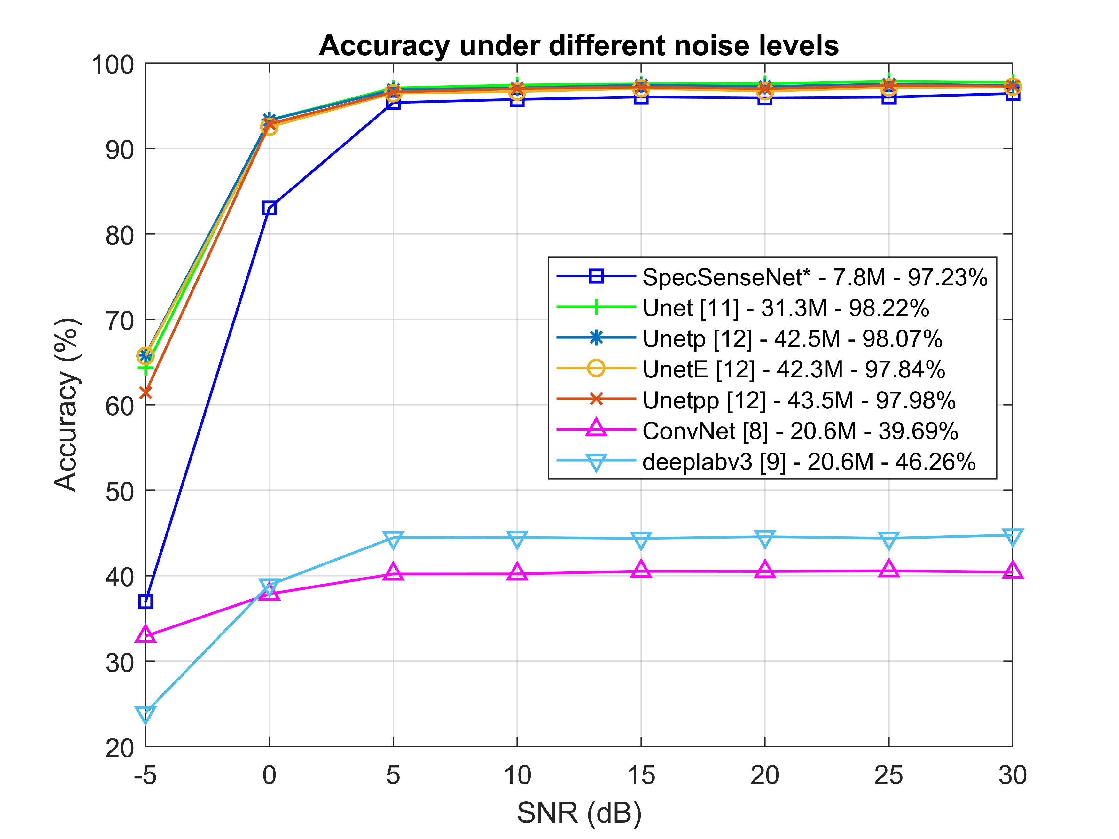
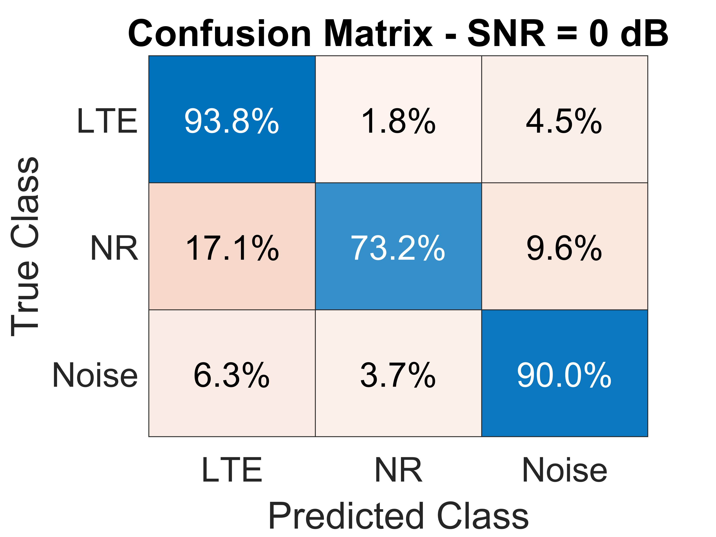
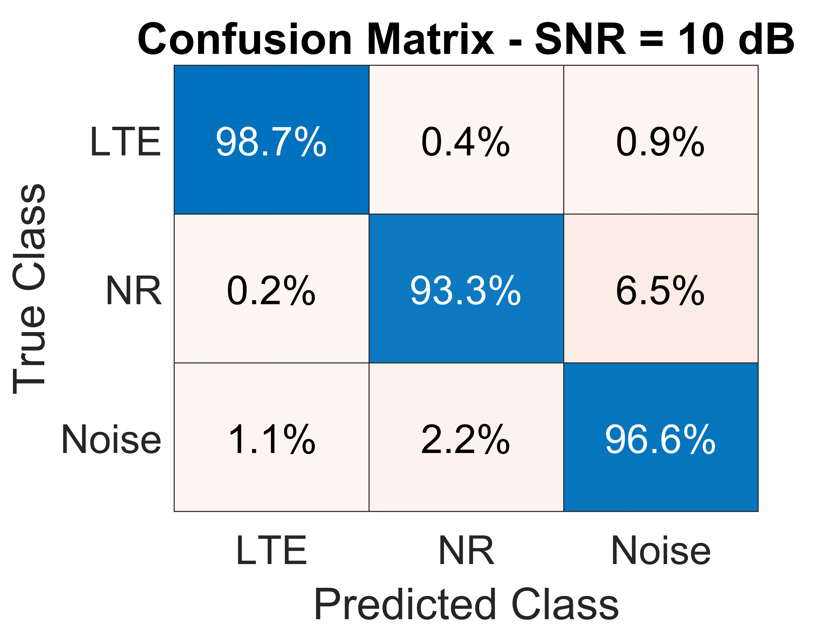

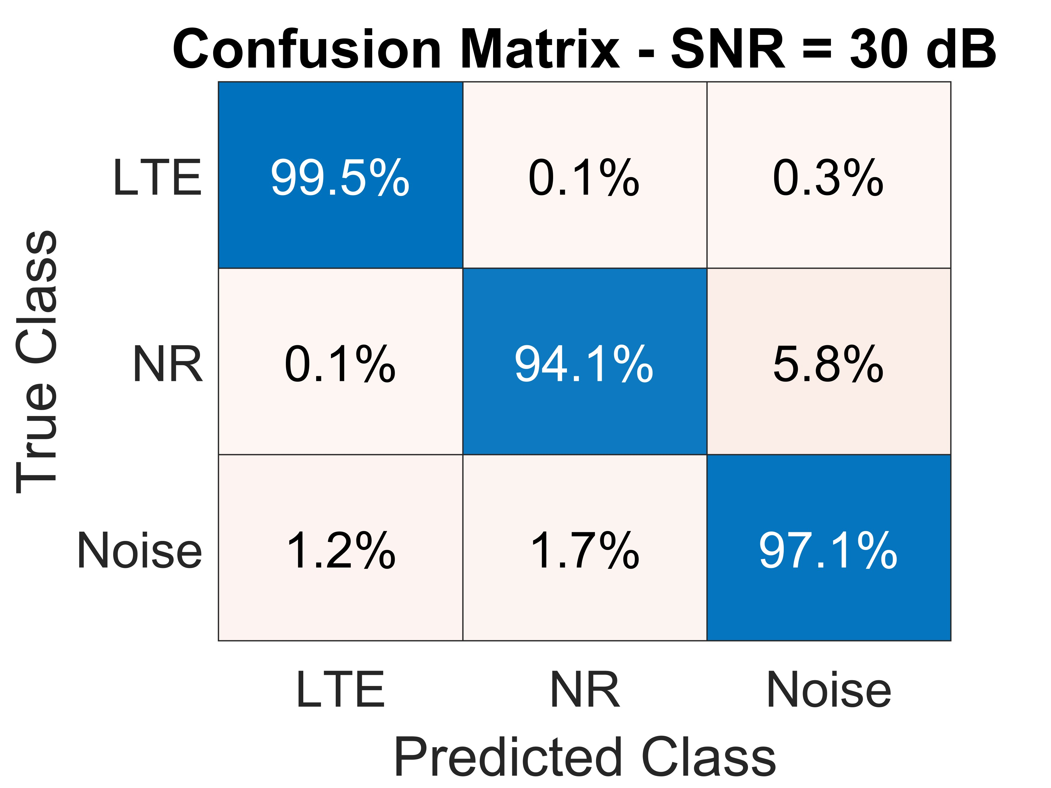
5. Evaluation result
2024 International Conference on Advanced Technologies for Communication (ATC’s 2024)
Comparison with other networks
Confusion matrix when evaluating SpecSenseNet under variable SNR ranges
[8] T. Huynh-The, Q.-V. Pham, T.-H. Vu, D. B. da Costa, and V.-P. Hoang,“Intelligent spectrum sensing with convnet for 5G and LTE signals identification,” in Proc. IEEE Statistical Signal Processing Workshop (SSP), Hanoi, Vietnam, Jul. 2023, pp. 140–144.
[9] G.-V. Nguyen, C. V. Phan, and T. Huynh-The, “Accurate spectrum sens_x0002_ing with improved DeepLabV3+ for 5G-LTE signals identification,” in Proc. 12th International Symposium on Information and CommunicationTechnology (SOICT), Ho Ch iMinh, Vietnam, Dec. 2023, pp. 221–227.
[11] W. Weng and X. Zhu, “INet: Convolutional networks for biomedical image segmentation,” IEEE Access, vol. 9, pp. 16 591–16 603, Jan. 2021.
[12] Z. Zhou, M. M. R. Siddiquee, N. Tajbakhsh, and J. Liang, “Unet++: Redesigning skip connections to exploit multiscale features in image segmentation,” IEEE Transactions on Medical Imaging, vol. 39, no. 6, pp. 1856–1867, Jun. 2019.

Slide 36
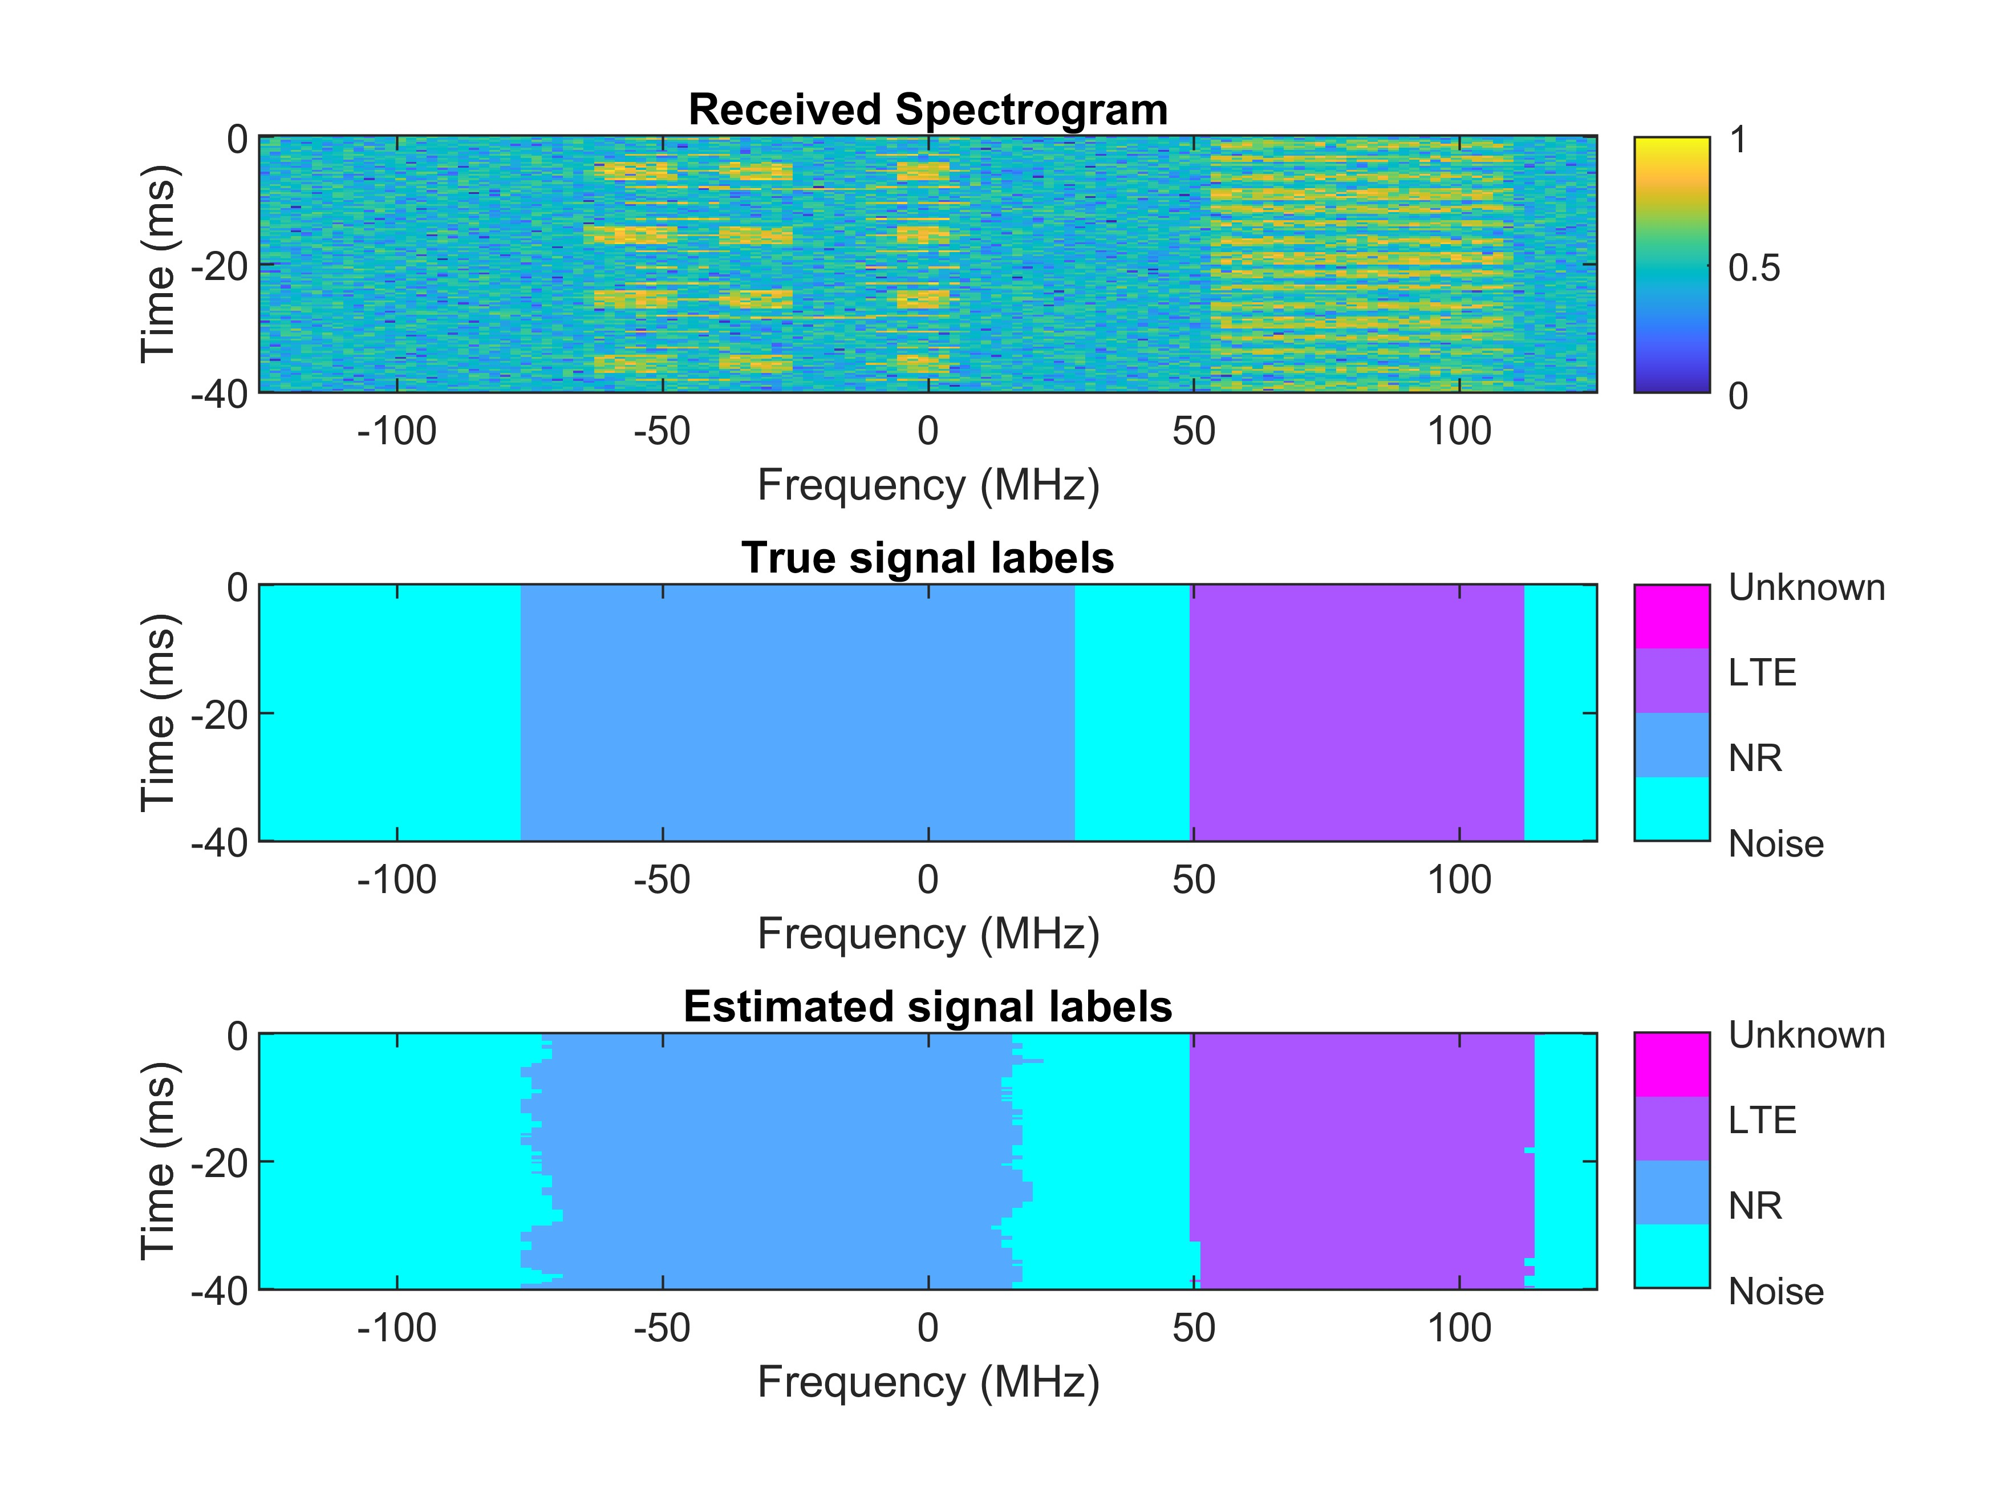
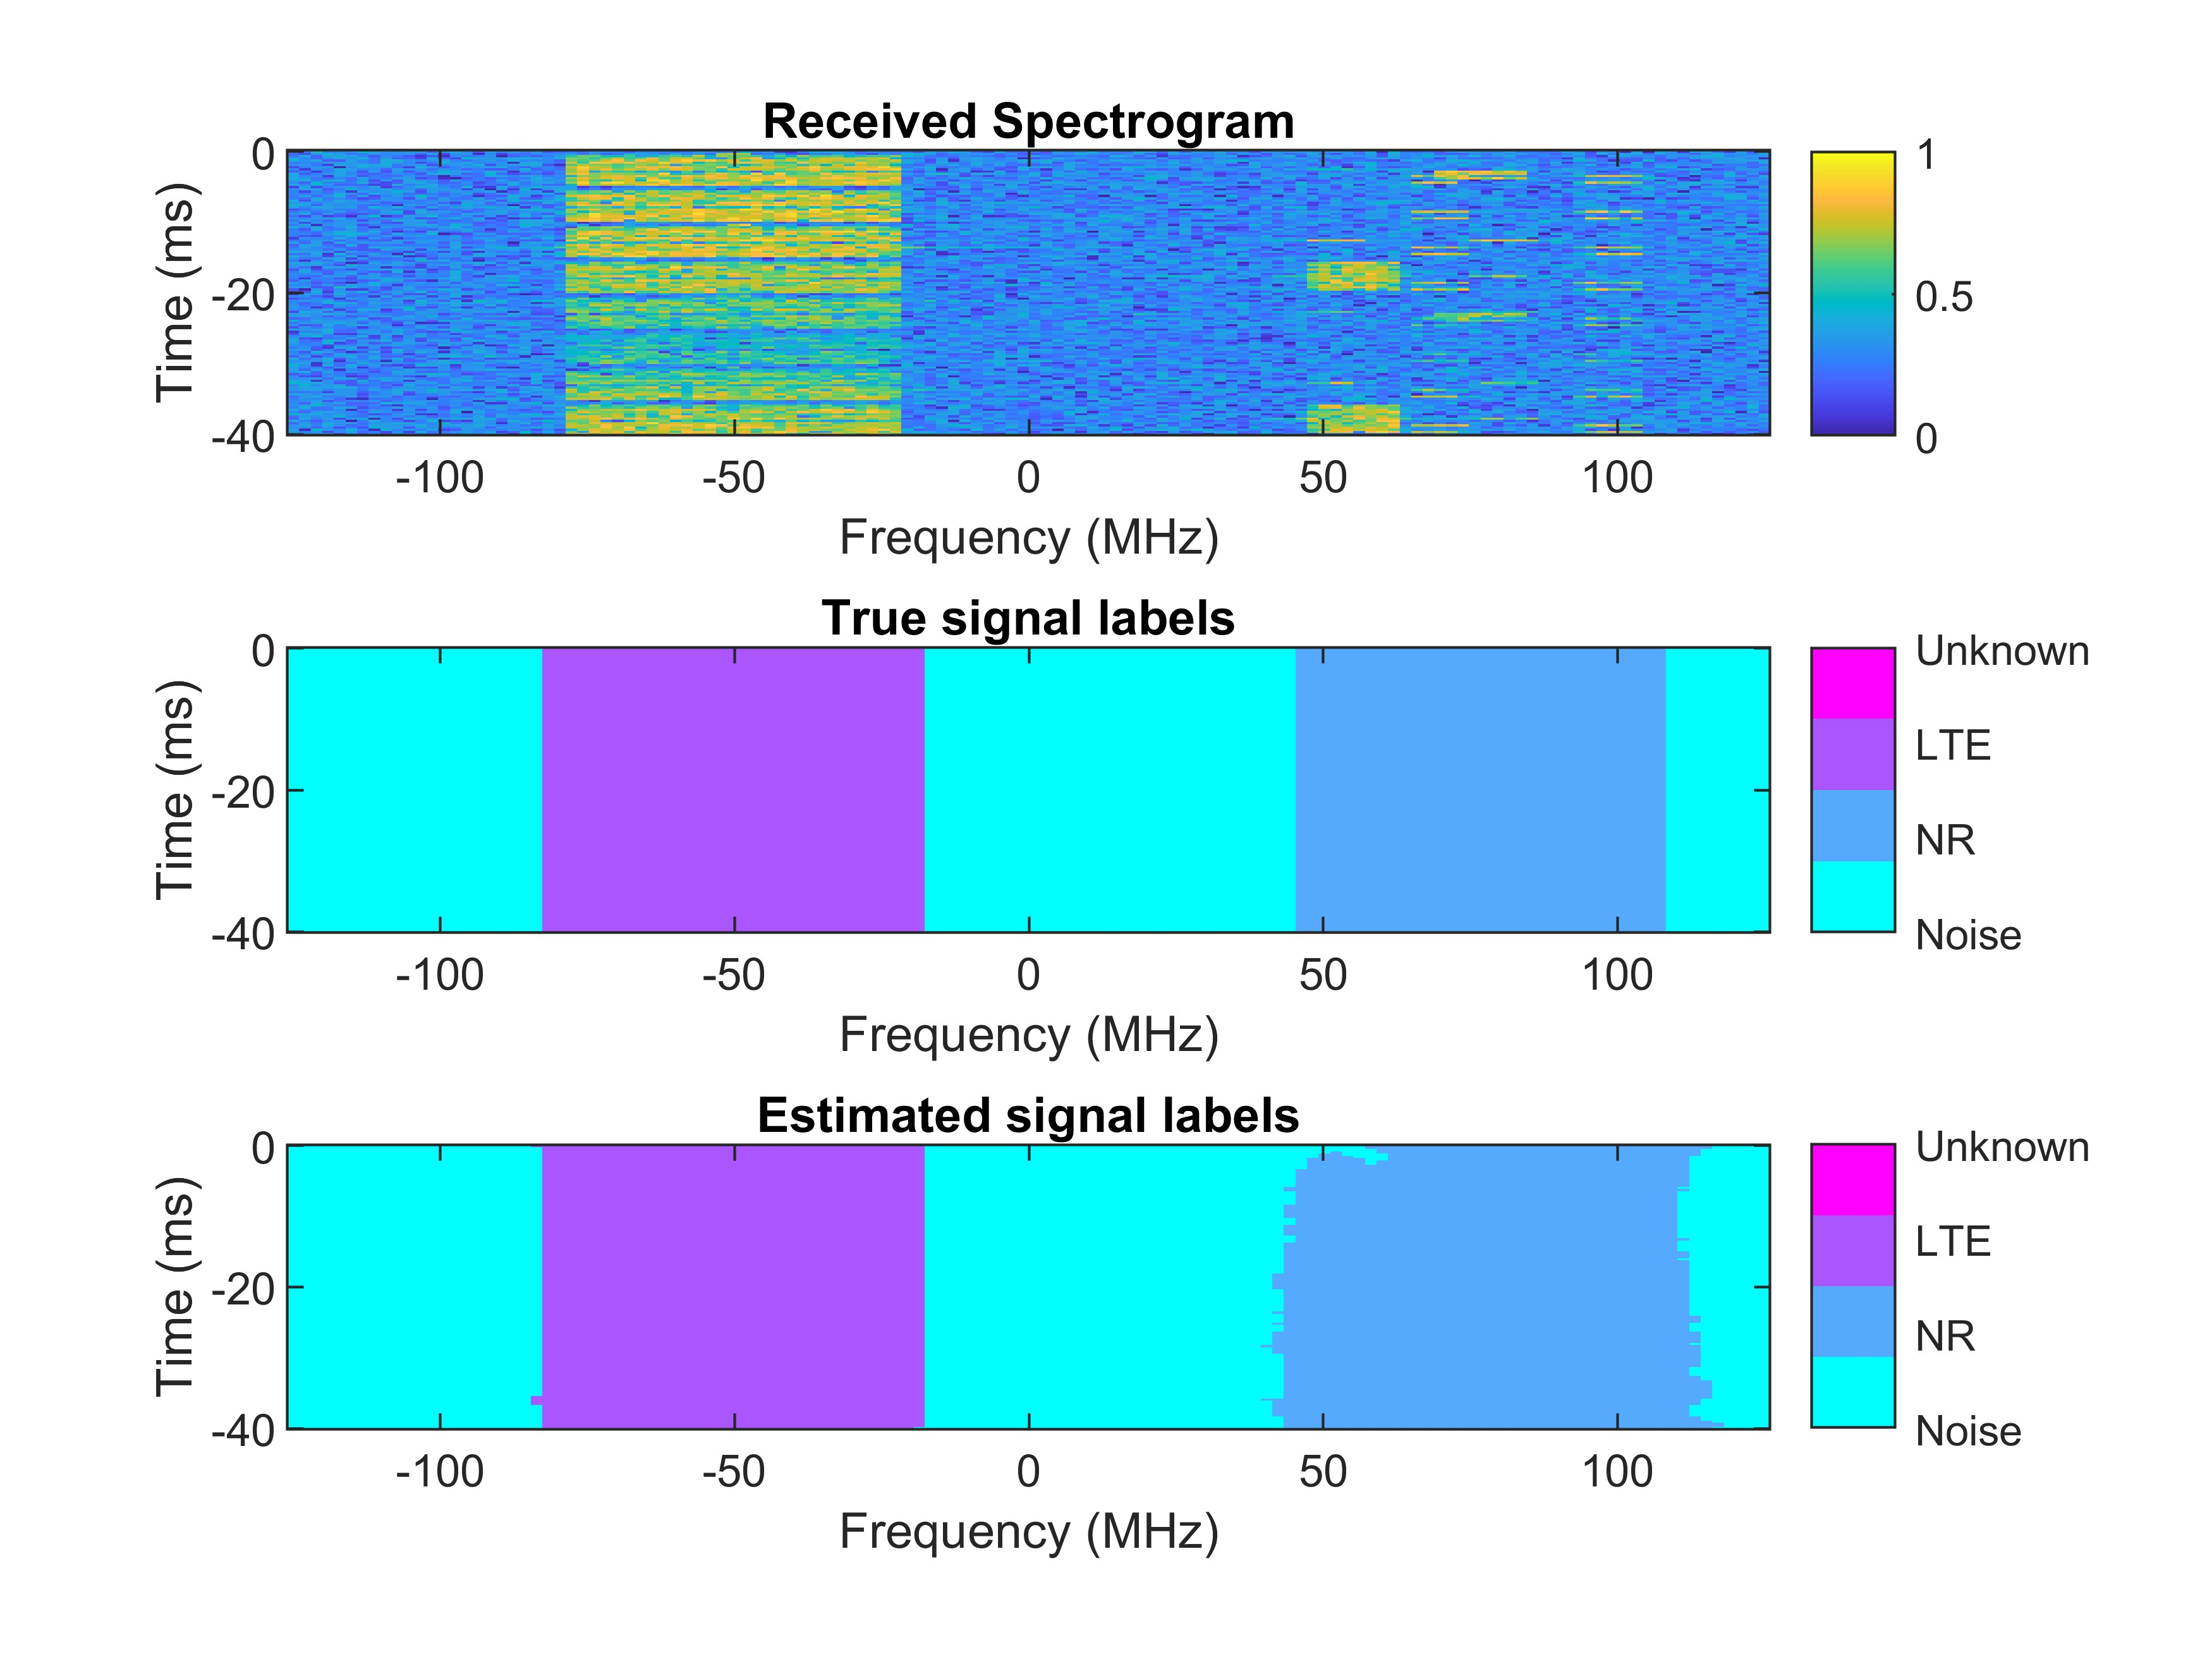
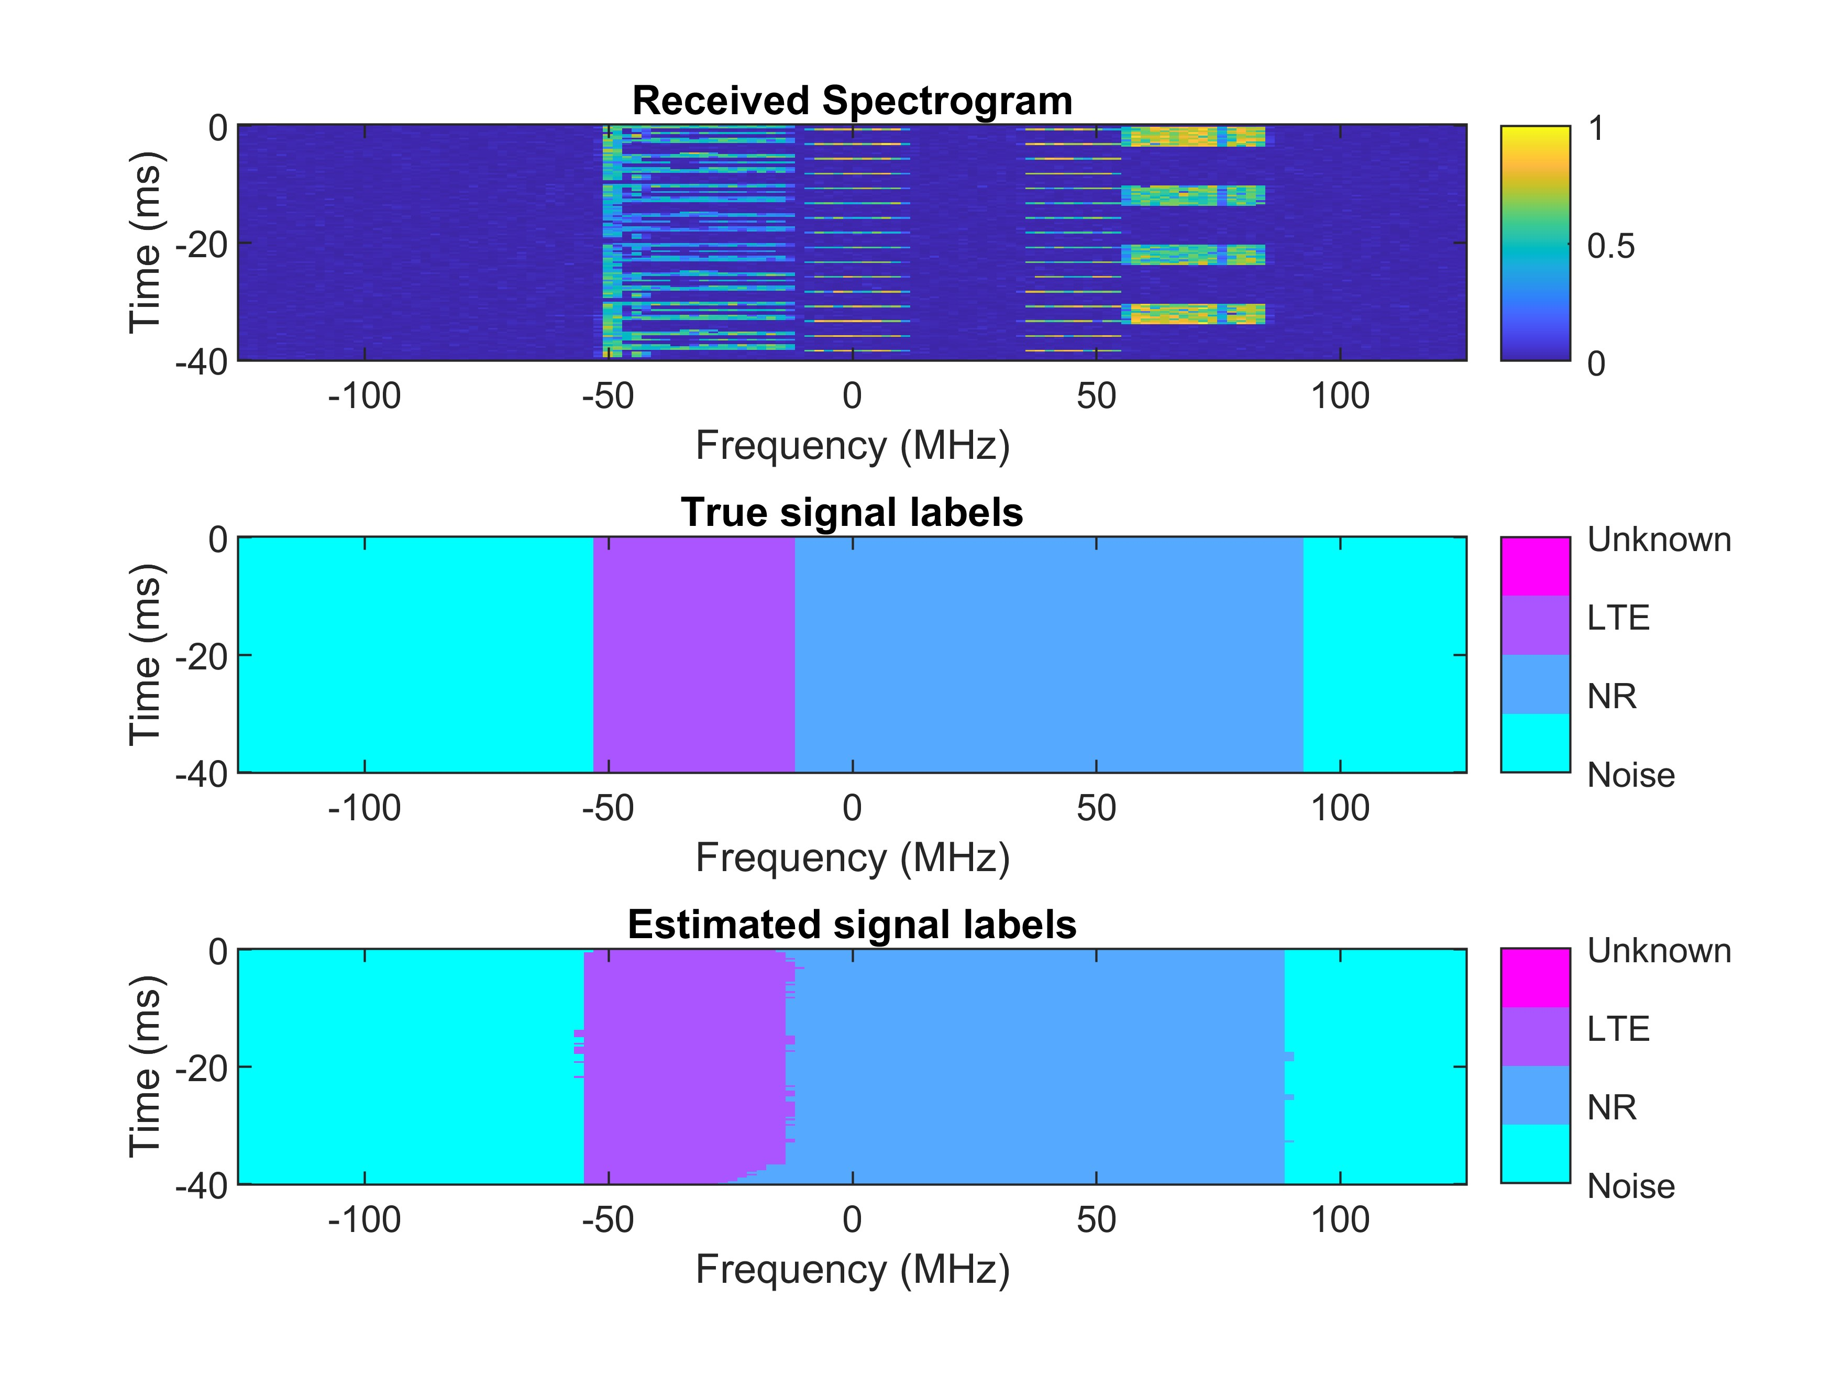
5. Evaluation result
2024 International Conference on Advanced Technologies for Communication (ATC’s 2024)
Visualization of received spectrograms in various SNR levels
5 dB
15 dB
30 dB

Slide 37
5. Evaluation result
2024 International Conference on Advanced Technologies for Communication (ATC’s 2024)
Visualization of received spectrograms in various SNR levels
5 dB
15 dB
30 dB
Occupied 5G NR signal

Slide 38
5. Evaluation result
2024 International Conference on Advanced Technologies for Communication (ATC’s 2024)
Visualization of received spectrograms in various SNR levels
5 dB
15 dB
30 dB
Occupied LTE signal

Slide 39
5. Evaluation result
2024 International Conference on Advanced Technologies for Communication (ATC’s 2024)
Visualization of received spectrograms in various SNR levels
5 dB
15 dB
30 dB
Unoccupied signal

Slide 40
References
2024 International Conference on Advanced Technologies for Communication (ATC’s 2024)
[1] T. Huynh-The, Q.-V. Pham, T.-V. Nguyen, T. T. Nguyen, R. Ruby, M. Zeng, and D.-S. Kim, “Automatic modulation classification: A deep architecture survey,” IEEE Access, vol. 9, pp. 142 950–142 971, Oct. 2021.
[2] T. Huynh-The, V.-P. Hoang, J.-W. Kim, M.-T. Le, and M. Zeng, “Wavenet: Toward waveform classification in integrated radar–communication systems with improved accuracy and reduced complexity,” IEEE Internet of Things Journal, vol. 11, no. 14, pp. 25 111–25 123, Jul. 2024.
[3] T. Yucek and H. Arslan, “A survey of spectrum sensing algorithms for cognitive radio applications,” IEEE Communications Surveys & Tutorials, vol. 11, no. 1, pp. 116–130, Mar. 2009.
[4] A. Kumar, N. Gaur, S. Chakravarty, M. H. Alsharif, P. Uthansakul, and M. Uthansakul, “Analysis of spectrum sensing using deep learning algorithms: CNNs and RNNs,” Ain Shams Engineering Journal, vol. 15, no. 3, p. 102505, Mar. 2024.
[5] A. Ali and W. Hamouda, “Advances on spectrum sensing for cogni_x0002_tive radio networks: Theory and applications,” IEEE Communications Surveys & Tutorials, vol. 19, no. 2, pp. 1277–1304, Jun. 2017.
[6] S. D. Liyanaarachchi, T. Riihonen, C. B. Barneto, and M. Valkama, “Optimized waveforms for 5G–6G communication with sensing: Theory, simulations and experiments,” IEEE Transactions on Wireless Commu_x0002_nications, vol. 20, no. 12, pp. 8301–8315, Dec. 2021.
[7] T. Huynh-The, N. C. Luong, H. Phan, D. B. da Costa, and Q.-V. Pham, “Improved waveform classification for integrated radar-communication 6G systems via convolutional neural networks,” IEEE Transactions on Vehicular Technology, pp. 1–5, Apr. 2024.
[8] T. Huynh-The, Q.-V. Pham, T.-H. Vu, D. B. da Costa, and V.-P. Hoang,“Intelligent spectrum sensing with convnet for 5G and LTE signals identification,” in Proc. IEEE Statistical Signal Processing Workshop (SSP), Hanoi, Vietnam, Jul. 2023, pp. 140–144.
[9] G.-V. Nguyen, C. V. Phan, and T. Huynh-The, “Accurate spectrum sens_x0002_ing with improved DeepLabV3+ for 5G-LTE signals identification,” in Proc. 12th International Symposium on Information and CommunicationTechnology (SOICT), Ho Ch iMinh, Vietnam, Dec. 2023, pp. 221–227.
[10] J. Gao, X. Yi, C. Zhong, X. Chen, and Z. Zhang, “Deep learning for spectrum sensing,” IEEE Wireless Communications Letters, vol. 8, no. 6, pp. 1727–1730, Dec. 2019.
[11] W. Weng and X. Zhu, “INet: Convolutional networks for biomedical image segmentation,” IEEE Access, vol. 9, pp. 16 591–16 603, Jan. 2021.
[12] Z. Zhou, M. M. R. Siddiquee, N. Tajbakhsh, and J. Liang, “Unet++: Redesigning skip connections to exploit multiscale features in image segmentation,” IEEE Transactions on Medical Imaging, vol. 39, no. 6, pp. 1856–1867, Jun. 2019.
[13] F. Chollet, “Xception: Deep learning with depthwise separable convo_x0002_lutions,” in Proc. IEEE Conference on Computer Vision and Pattern Recognition (CVPR), Honolulu, HI, USA, Nov. 2017, pp. 1800–1807.
[14] M. Z. Alom, C. Yakopcic, T. M. Taha, and V. K. Asari, “Nuclei seg_x0002_mentation with recurrent residual convolutional neural networks based U-Net (R2U-Net),” in Proc. IEEE National Aerospace and Electronics Conference, Dayton, OH, USA, Dec. 2018, pp. 228–233.
[15] K. He, X. Zhang, S. Ren, and J. Sun, “Deep residual learning for image recognition,” in Proc. IEEE Conference on Computer Vision and Pattern Recognition (CVPR), Las Vegas, NV, USA, Dec. 2016, pp. 770–778.
[16] M. Aghalari, A. Aghagolzadeh, and M. Ezoji, “Brain tumor image segmentation via asymmetric/symmetric unet based on two-pathway_x0002_residual blocks,” Biomedical Signal Processing and Control, vol. 69, p.102841, Aug. 2021.
[17] L.-C. Chen, G. Papandreou, I. Kokkinos, K. Murphy, and A. L. Yuille, “DeepLab: Semantic image segmentation with deep convolutional nets, atrous convolution, and fully connected crfs,” IEEE Transactions on Pattern Analysis and Machine Intelligence, vol. 40, no. 4, pp. 834–848, Apr. 2018.
[18] X. Lin and N. Lee, “5G and beyond,” Cham, Switzerland: Springer Nature Switzerland AG, 2021.

Slide 41
2024 International Conference on Advanced Technologies for Communication (ATC’s 2024)
ATC 2024
2024 International Conference On Advanced Technologies For Communications
17 - 19, October, 2024, Ho Chi Minh City, Vietnam
THANK YOU FOR YOUR ATTENTION

